Slide 1

Reading Group: Recursive Estimation of Time-Average Variance Constants (Wu, 2009)
Heman Leung
Spring, 2020

Slide 2
Introduction
Section 1

Slide 3
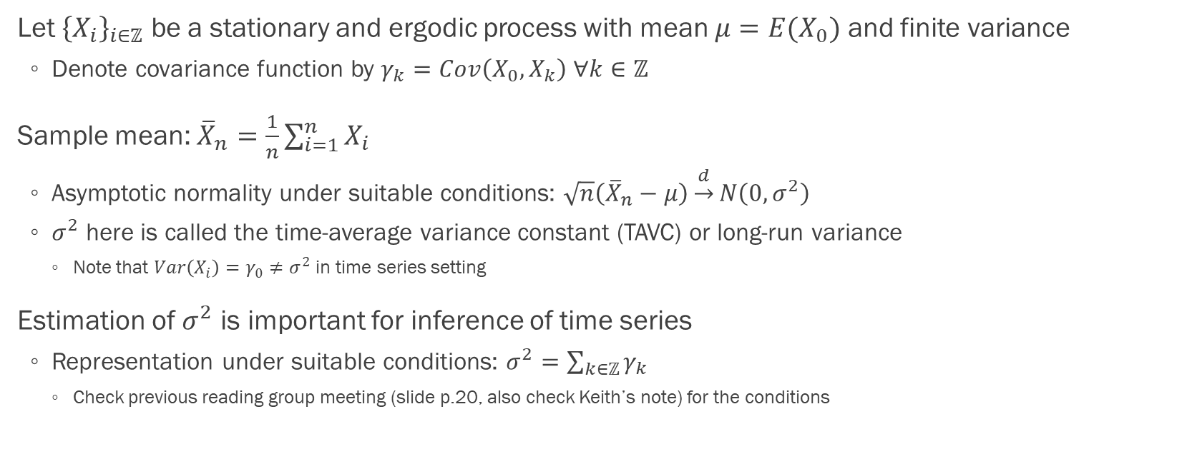
Time-average variance constant (p.1)
Let ${\left\{X_{i}\right\}}_{i∈ℤ}$ be a stationary and ergodic process with mean $μ=E(X_{0})$ and finite variance
Denote covariance function by $γ_{k}=Cov\left(X_{0},X_{k}\right) ∀k∈ℤ$
Sample mean: ${\overline{X}}_{n}=\frac{1}{n}\sum_{i=1}^{n}{X_{i}}$
Asymptotic normality under suitable conditions: $\sqrt{n}\left({\overline{X}}_{n}−μ\right)\underset{→}{d}N\left(0,σ^{2}\right)$
$σ^{2}$ here is called the time-average variance constant (TAVC) or long-run variance
Note that $Var\left(X_{i}\right)=γ_{0}≠σ^{2}$ in time series setting
Estimation of $σ^{2}$ is important for inference of time series
Representation under suitable conditions: $σ^{2}=\sum_{k∈ℤ}{γ_{k}}$
Check previous reading group meeting (slide p.20, also check Keith’s note) for the conditions

Slide 4
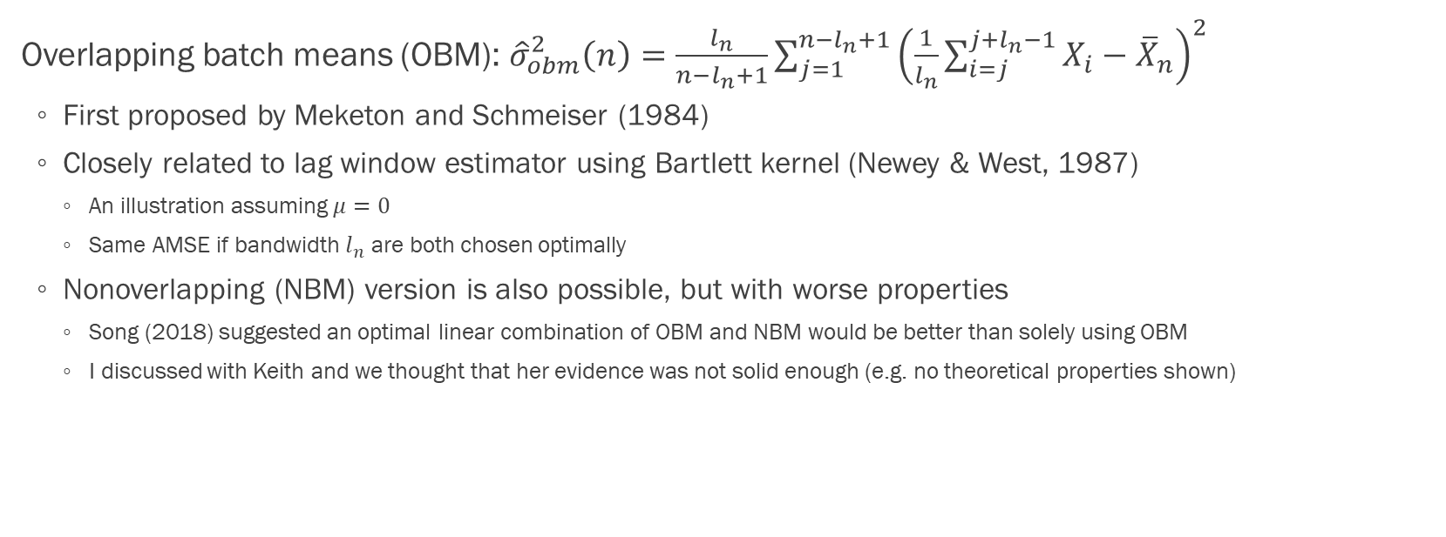
Overlapping batch means (p.2)
Overlapping batch means (OBM): ${\hat{σ}}_{obm}^{2}\left(n\right)=\frac{l_{n}}{n−l_{n}+1}\sum_{j=1}^{n−l_{n}+1}{{\left(\frac{1}{l_{n}}\sum_{i=j}^{j+l_{n}−1}{X_{i}−{\overline{X}}_{n}}\right)}^{2}}$
First proposed by Meketon and Schmeiser (1984)
Closely related to lag window estimator using Bartlett kernel (Newey & West, 1987)
An illustration assuming $μ=0$
Same AMSE if bandwidth $l_{n}$ are both chosen optimally
Nonoverlapping (NBM) version is also possible, but with worse properties
Song (2018) suggested an optimal linear combination of OBM and NBM would be better than solely using OBM
I discussed with Keith and we thought that her evidence was not solid enough (e.g. no theoretical properties shown)

Slide 5
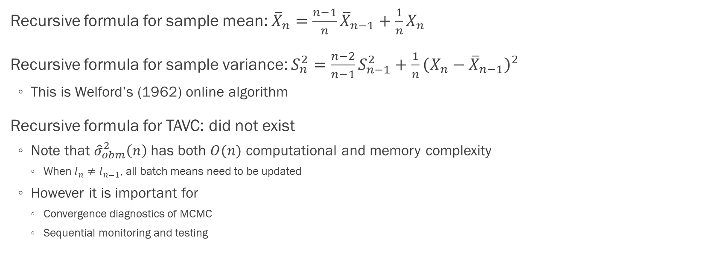
Recursive estimation
Recursive formula for sample mean: ${\overline{X}}_{n}=\frac{n−1}{n}{\overline{X}}_{n−1}+\frac{1}{n}X_{n}$
Recursive formula for sample variance: $S_{n}^{2}=\frac{n−2}{n−1}S_{n−1}^{2}+\frac{1}{n}{\left(X_{n}−{\overline{X}}_{n−1}\right)}^{2}$
This is Welford’s (1962) online algorithm
Recursive formula for TAVC: did not exist
Note that ${\hat{σ}}_{obm}^{2}\left(n\right)$ has both $O(n)$ computational and memory complexity
When $l_{n}≠l_{n−1}$, all batch means need to be updated
However it is important for
Convergence diagnostics of MCMC
Sequential monitoring and testing

Slide 6
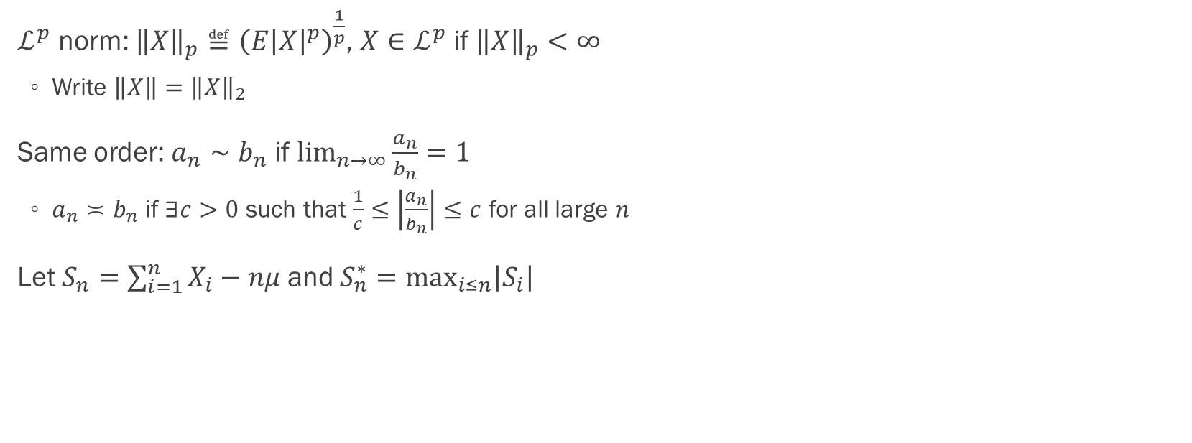
Notations (p.3)
$ℒ^{p}$ norm: ${\left\|X\right\|}_{p}≝{\left(E{\left|X\right|}^{p}\right)}^{\frac{1}{p}}$, $X∈ℒ^{p}$ if ${\left\|X\right\|}_{p}<∞$
Write $\left\|X\right\|={\left\|X\right\|}_{2}$
Same order: $a_{n}∼b_{n}$ if $\lim_{n→∞}{\frac{a_{n}}{b_{n}}}=1$
$a_{n}≍b_{n}$ if $∃c>0$ such that $\frac{1}{c}≤\left|\frac{a_{n}}{b_{n}}\right|≤c$ for all large $n$
Let $S_{n}=\sum_{i=1}^{n}{X_{i}}−nμ$ and $S_{n}^{∗}=\max_{i≤n}\left|S_{i}\right|$

Slide 7
Recursive TAVC estimates
Section 2

Slide 8
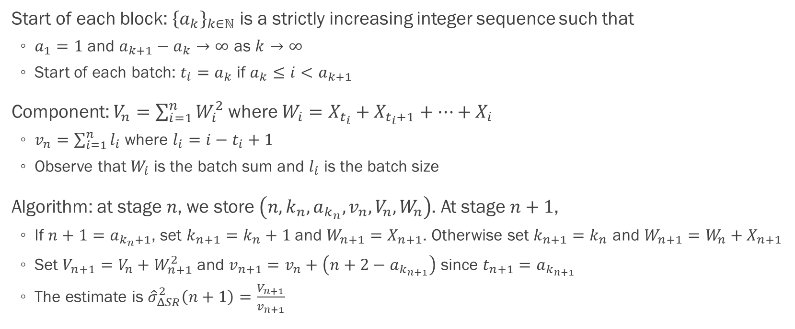

Algorithm when $μ=0$
Start of each block: ${\left\{a_{k}\right\}}_{k∈ℕ}$ is a strictly increasing integer sequence such that
$a_{1}=1$ and $a_{k+1}−a_{k}→∞$ as $k→∞$
Start of each batch: $t_{i}=a_{k}$ if $a_{k}≤i<a_{k+1}$
Component: $V_{n}=\sum_{i=1}^{n}{W_{i}^{2}}$ where $W_{i}=X_{t_{i}}+X_{t_{i}+1}+…+X_{i}$
$v_{n}=\sum_{i=1}^{n}{l_{i}}$ where $l_{i}=i−t_{i}+1$
Observe that $W_{i}$ is the batch sum and $l_{i}$ is the batch size
Algorithm: at stage $n$, we store $\left(n,k_{n},a_{k_{n}},v_{n},V_{n},W_{n}\right)$. At stage $n+1$,
If $n+1=a_{k_{n}+1}$, set $k_{n+1}=k_{n}+1$ and $W_{n+1}=X_{n+1}$. Otherwise set $k_{n+1}=k_{n}$ and $W_{n+1}=W_{n}+X_{n+1}$
Set $V_{n+1}=V_{n}+W_{n+1}^{2}$ and $v_{n+1}=v_{n}+\left(n+2−a_{k_{n+1}}\right)$ since $t_{n+1}=a_{k_{n+1}}$
The estimate is ${\hat{σ}}_{ΔSR}^{2}\left(n+1\right)=\frac{V_{n+1}}{v_{n+1}}$

Slide 9
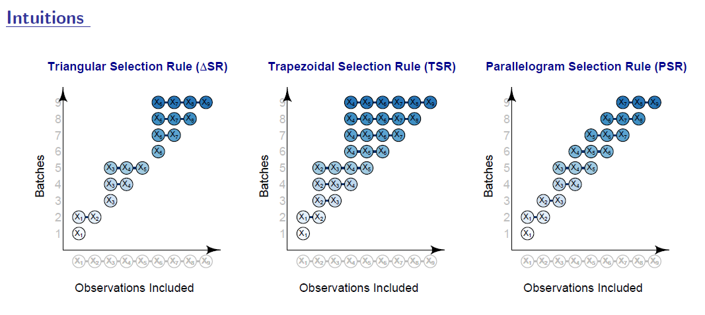
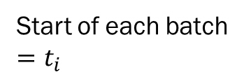
Graphical illustration (Chan and Yau, 2017)
Start of each batch $=t_{i}$
Start of each block $=a_{k}$; thus a block $B_{k}$ contains $\left\{a_{k},a_{k}+1,…,a_{k+1}−1\right\}$

Slide 10
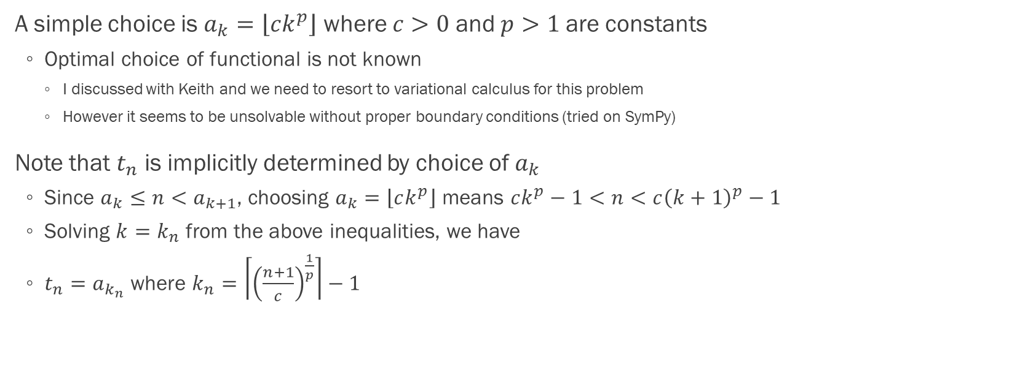

Choice of $a_{k}$ and $t_{n}$ (p.3-4)
A simple choice is $a_{k}=\left\lfloor ck^{p}\right\rfloor$ where $c>0$ and $p>1$ are constants
Optimal choice of functional is not known
I discussed with Keith and we need to resort to variational calculus for this problem
However it seems to be unsolvable without proper boundary conditions (tried on SymPy)
Note that $t_{n}$ is implicitly determined by choice of $a_{k}$
Since $a_{k}≤n<a_{k+1}$, choosing $a_{k}=\left\lfloor ck^{p}\right\rfloor$ means $ck^{p}−1<n<c{\left(k+1\right)}^{p}−1$
Solving $k=k_{n}$ from the above inequalities, we have
$t_{n}=a_{k_{n}}$ where $k_{n}=\left\lceil {\left(\frac{n+1}{c}\right)}^{\frac{1}{p}}\right\rceil −1$

Slide 11
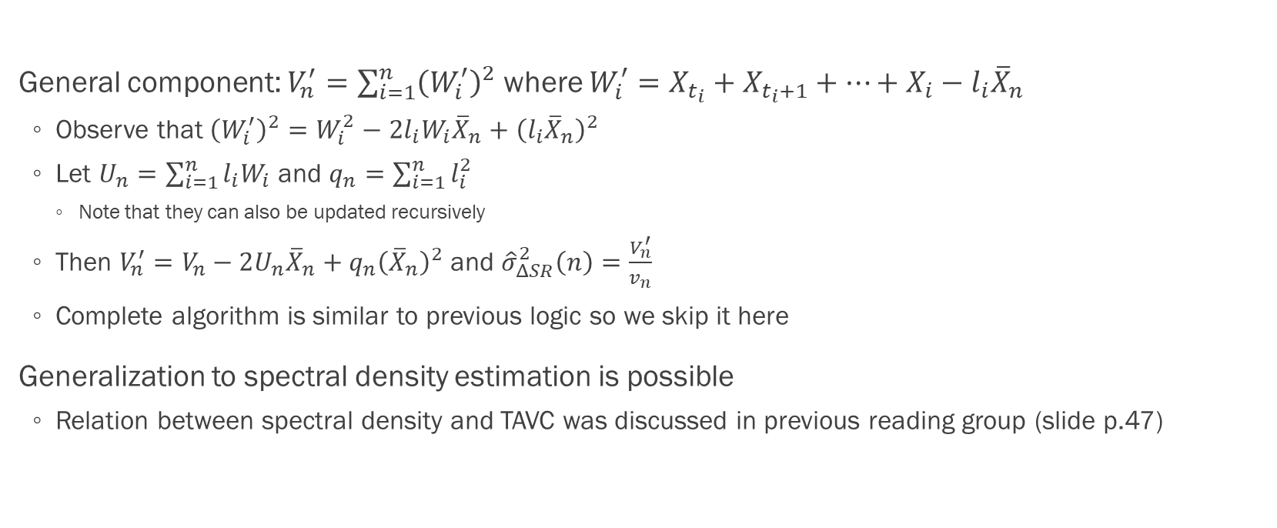
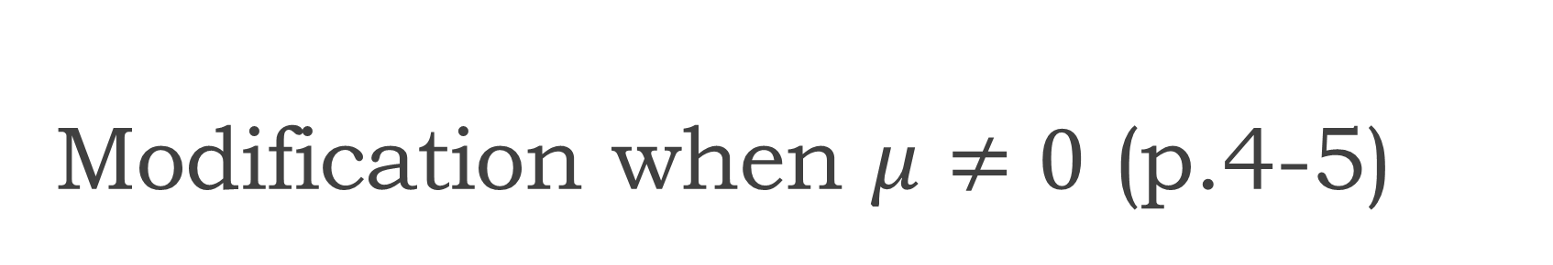
Modification when $μ≠0$ (p.4-5)
General component: $V_{n}^{′}=\sum_{i=1}^{n}{{\left(W_{i}^{′}\right)}^{2}}$ where $W_{i}^{′}=X_{t_{i}}+X_{t_{i}+1}+…+X_{i}−l_{i}{\overline{X}}_{n}$
Observe that ${\left(W_{i}^{′}\right)}^{2}=W_{i}^{2}−2l_{i}W_{i}{\overline{X}}_{n}+{\left(l_{i}{\overline{X}}_{n}\right)}^{2}$
Let $U_{n}=\sum_{i=1}^{n}{l_{i}W_{i}}$ and $q_{n}=\sum_{i=1}^{n}{l_{i}^{2}}$
Note that they can also be updated recursively
Then $V_{n}^{′}=V_{n}−2U_{n}{\overline{X}}_{n}+q_{n}{\left({\overline{X}}_{n}\right)}^{2}$ and ${\hat{σ}}_{ΔSR}^{2}\left(n\right)=\frac{V_{n}^{′}}{v_{n}}$
Complete algorithm is similar to previous logic so we skip it here
Generalization to spectral density estimation is possible
Relation between spectral density and TAVC was discussed in previous reading group (slide p.47)

Slide 12
Convergence properties
Section 3

Slide 13
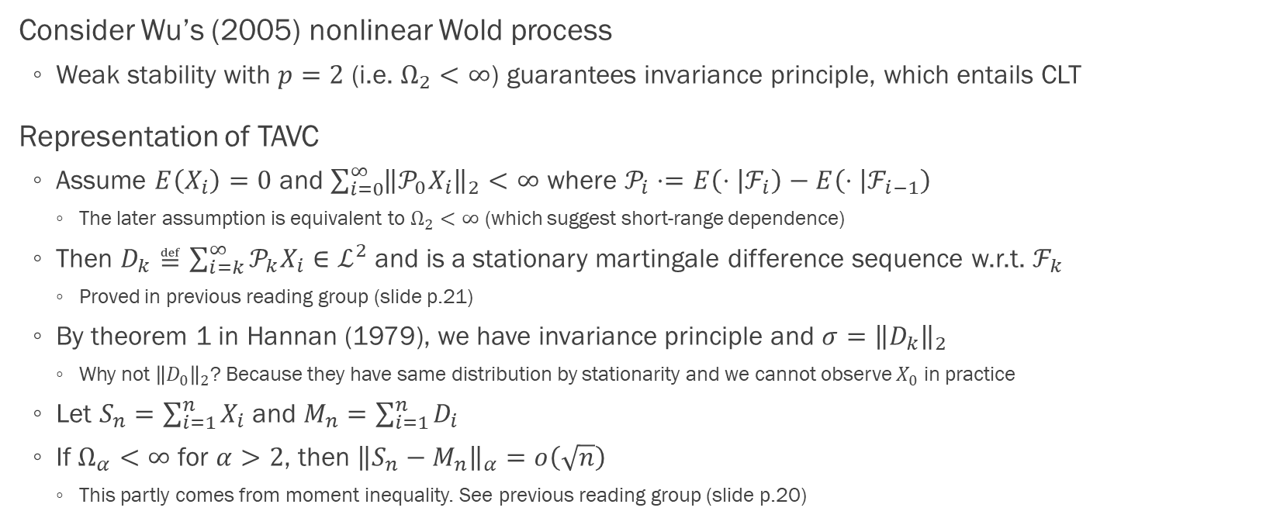
Representation of TAVC (p.5-6)
Consider Wu’s (2005) nonlinear Wold process
Weak stability with $p=2$ (i.e. $Ω_{2}<∞$) guarantees invariance principle, which entails CLT
Representation of TAVC
Assume $E\left(X_{i}\right)=0$ and $\sum_{i=0}^{∞}{{\left\|𝒫_{0}X_{i}\right\|}_{2}}<∞$ where $𝒫_{i}⋅=E\left(⋅ | ℱ_{i}\right)−E\left(⋅ | ℱ_{i−1}\right)$
The later assumption is equivalent to $Ω_{2}<∞$ (which suggest short-range dependence)
Then $D_{k}≝\sum_{i=k}^{∞}{𝒫_{k}X_{i}}∈ℒ^{2}$ and is a stationary martingale difference sequence w.r.t. $ℱ_{k}$
Proved in previous reading group (slide p.21)
By theorem 1 in Hannan (1979), we have invariance principle and $σ={\left\|D_{k}\right\|}_{2}$
Why not ${\left\|D_{0}\right\|}_{2}$? Because they have same distribution by stationarity and we cannot observe $X_{0}$ in practice
Let $S_{n}=\sum_{i=1}^{n}{X_{i}}$ and $M_{n}=\sum_{i=1}^{n}{D_{i}}$
If $Ω_{α}<∞$ for $α>2$, then ${\left\|S_{n}−M_{n}\right\|}_{α}=o\left(\sqrt{n}\right)$
This partly comes from moment inequality. See previous reading group (slide p.20)

Slide 14
Moment convergence
Section 3.1

Slide 15
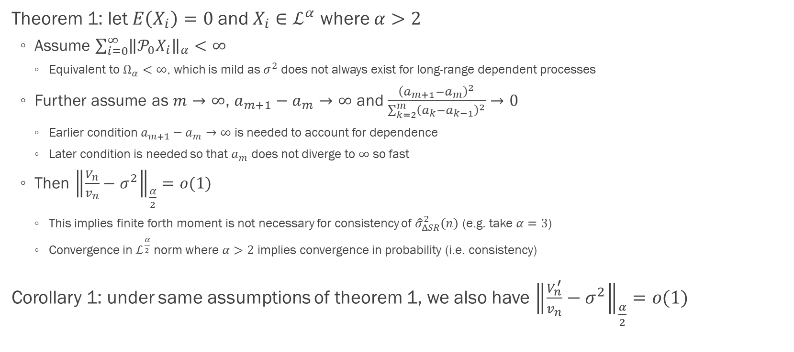
Moment convergence (p.6-7)
Theorem 1: let $E\left(X_{i}\right)=0$ and $X_{i}∈ℒ^{α}$ where $α>2$
Assume $\sum_{i=0}^{∞}{{\left\|𝒫_{0}X_{i}\right\|}_{α}}<∞$
Equivalent to $Ω_{α}<∞$, which is mild as $σ^{2}$ does not always exist for long-range dependent processes
Further assume as $m→∞$, $a_{m+1}−a_{m}→∞$ and $\frac{{\left(a_{m+1}−a_{m}\right)}^{2}}{\sum_{k=2}^{m}{{\left(a_{k}−a_{k−1}\right)}^{2}}}→0$
Earlier condition $a_{m+1}−a_{m}→∞$ is needed to account for dependence
Later condition is needed so that $a_{m}$ does not diverge to $∞$ so fast
Then ${\left\|\frac{V_{n}}{v_{n}}−σ^{2}\right\|}_{\frac{α}{2}}=o(1)$
This implies finite forth moment is not necessary for consistency of ${\hat{σ}}_{ΔSR}^{2}\left(n\right)$ (e.g. take $α=3$)
Convergence in $ℒ^{\frac{α}{2}}$ norm where $α>2$ implies convergence in probability (i.e. consistency)
Corollary 1: under same assumptions of theorem 1, we also have ${\left\|\frac{V_{n}^{′}}{v_{n}}−σ^{2}\right\|}_{\frac{α}{2}}=o(1)$

Slide 16
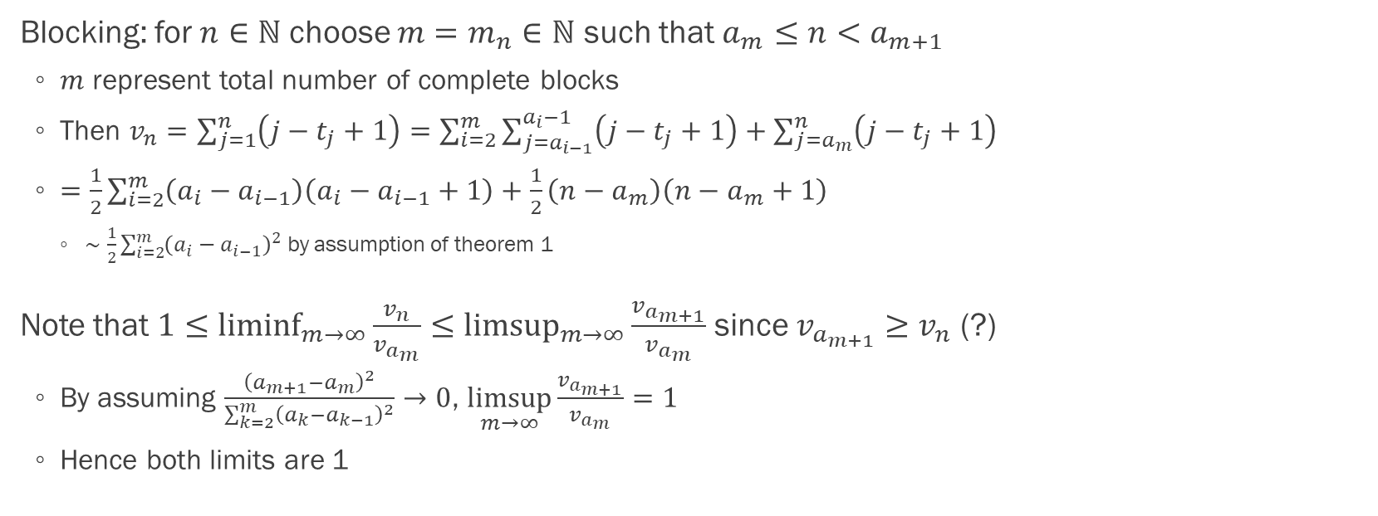
Proof of theorem 1: blocking (p.13)
Blocking: for $n∈ℕ$ choose $m=m_{n}∈ℕ$ such that $a_{m}≤n<a_{m+1}$
$m$ represent total number of complete blocks
Then $v_{n}=\sum_{j=1}^{n}{\left(j−t_{j}+1\right)}=\sum_{i=2}^{m}{\sum_{j=a_{i−1}}^{a_{i}−1}{\left(j−t_{j}+1\right)}}+\sum_{j=a_{m}}^{n}{\left(j−t_{j}+1\right)}$
$=\frac{1}{2}\sum_{i=2}^{m}{\left(a_{i}−a_{i−1}\right)\left(a_{i}−a_{i−1}+1\right)}+\frac{1}{2}\left(n−a_{m}\right)\left(n−a_{m}+1\right)$
$∼\frac{1}{2}\sum_{i=2}^{m}{{\left(a_{i}−a_{i−1}\right)}^{2}}$ by assumption of theorem 1
Note that $1≤\underset{m→∞}{liminf}{\frac{v_{n}}{v_{a_{m}}}}≤\underset{m→∞}{limsup}{\frac{v_{a_{m+1}}}{v_{a_{m}}}}$ since $v_{a_{m+1}}≥v_{n}$ (?)
By assuming $\frac{{\left(a_{m+1}−a_{m}\right)}^{2}}{\sum_{k=2}^{m}{{\left(a_{k}−a_{k−1}\right)}^{2}}}→0$, $\underset{m→∞}{limsup}{\frac{v_{a_{m+1}}}{v_{a_{m}}}}=1$
Hence both limits are 1

Slide 17
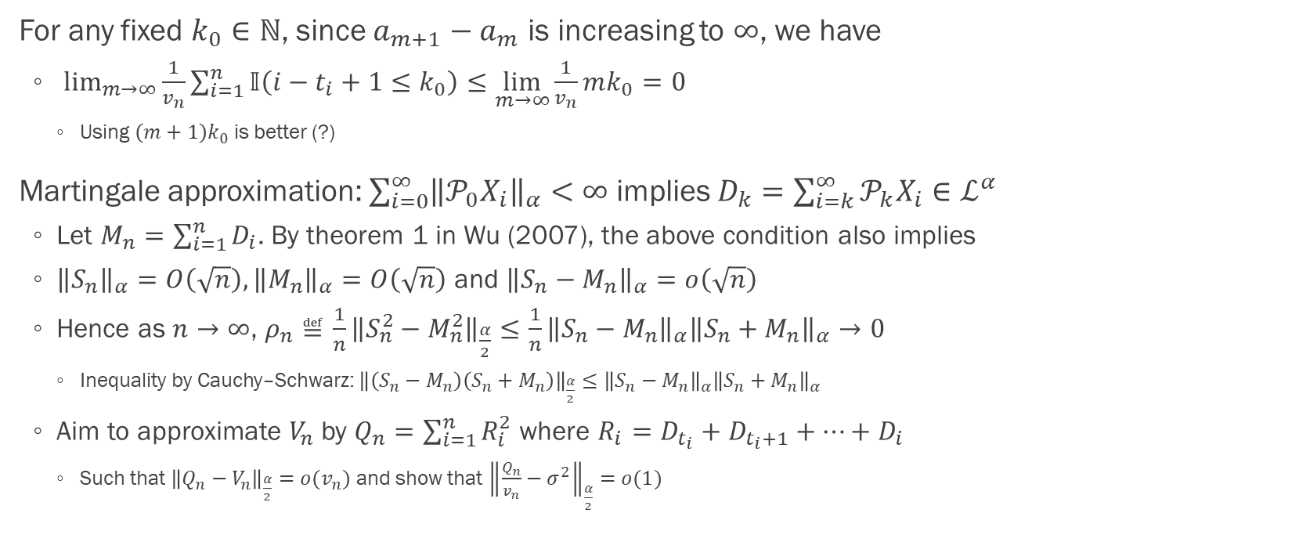
Proof of theorem 1: martingale approximation (p.13)
For any fixed $k_{0}∈ℕ$, since $a_{m+1}−a_{m}$ is increasing to $∞$, we have
$\lim_{m→∞}{\frac{1}{v_{n}}\sum_{i=1}^{n}{𝕀\left(i−t_{i}+1≤k_{0}\right)}}≤\lim_{m→∞}{\frac{1}{v_{n}}mk_{0}}=0$
Using $\left(m+1\right)k_{0}$ is better (?)
Martingale approximation: $\sum_{i=0}^{∞}{{\left\|𝒫_{0}X_{i}\right\|}_{α}}<∞$ implies $D_{k}=\sum_{i=k}^{∞}{𝒫_{k}X_{i}}∈ℒ^{α}$
Let $M_{n}=\sum_{i=1}^{n}{D_{i}}$. By theorem 1 in Wu (2007), the above condition also implies
${\left\|S_{n}\right\|}_{α}=O\left(\sqrt{n}\right),{\left\|M_{n}\right\|}_{α}=O\left(\sqrt{n}\right)$ and ${\left\|S_{n}−M_{n}\right\|}_{α}=o\left(\sqrt{n}\right)$
Hence as $n→∞$, $ρ_{n}≝\frac{1}{n}{\left\|S_{n}^{2}−M_{n}^{2}\right\|}_{\frac{α}{2}}≤\frac{1}{n}{\left\|S_{n}−M_{n}\right\|}_{α}{\left\|S_{n}+M_{n}\right\|}_{α}→0$
Inequality by Cauchy–Schwarz: ${\left\|\left(S_{n}−M_{n}\right)\left(S_{n}+M_{n}\right)\right\|}_{\frac{α}{2}}≤{\left\|S_{n}−M_{n}\right\|}_{α}{\left\|S_{n}+M_{n}\right\|}_{α}$
Aim to approximate $V_{n}$ by $Q_{n}=\sum_{i=1}^{n}{R_{i}^{2}}$ where $R_{i}=D_{t_{i}}+D_{t_{i}+1}+…+D_{i}$
Such that ${\left\|Q_{n}−V_{n}\right\|}_{\frac{α}{2}}=o(v_{n})$ and show that ${\left\|\frac{Q_{n}}{v_{n}}−σ^{2}\right\|}_{\frac{α}{2}}=o(1)$

Slide 18
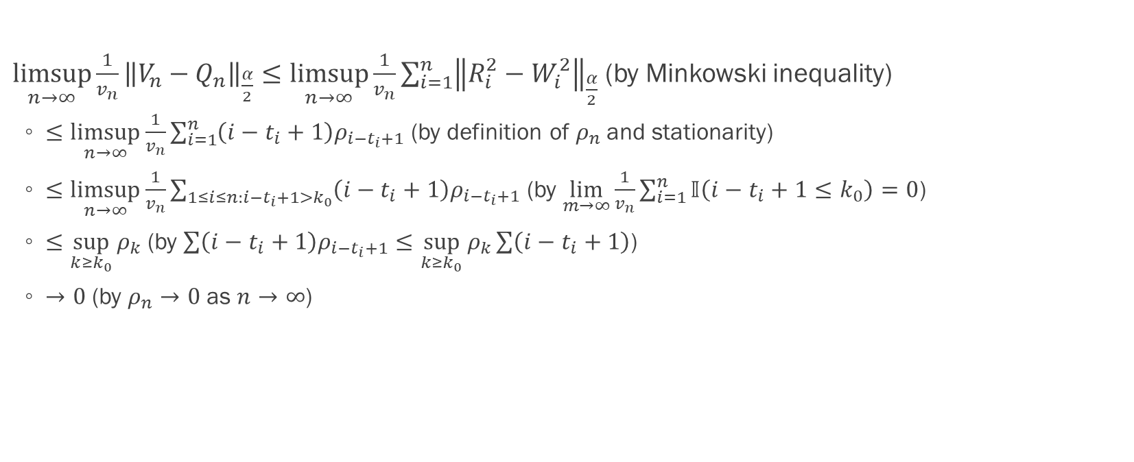
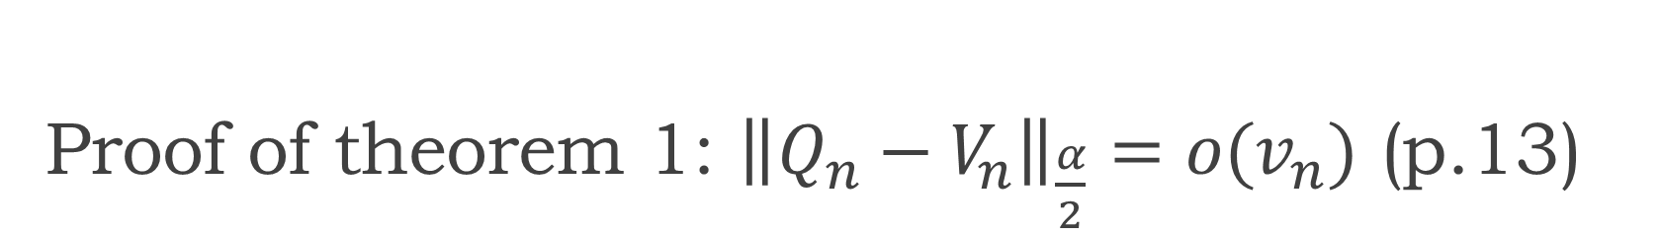
Proof of theorem 1: ${\left\|Q_{n}−V_{n}\right\|}_{\frac{α}{2}}=o(v_{n})$ (p.13)
$\underset{n→∞}{limsup}{\frac{1}{v_{n}}{\left\|V_{n}−Q_{n}\right\|}_{\frac{α}{2}}}≤\underset{n→∞}{limsup}{\frac{1}{v_{n}}\sum_{i=1}^{n}{{\left\|R_{i}^{2}−W_{i}^{2}\right\|}_{\frac{α}{2}}}}$ (by Minkowski inequality)
$≤\underset{n→∞}{limsup}{\frac{1}{v_{n}}\sum_{i=1}^{n}{\left(i−t_{i}+1\right)ρ_{i−t_{i}+1}}}$ (by definition of $ρ_{n}$ and stationarity)
$≤\underset{n→∞}{limsup}{\frac{1}{v_{n}}\sum_{1≤i≤n:i−t_{i}+1>k_{0}}{\left(i−t_{i}+1\right)ρ_{i−t_{i}+1}}}$ (by $\lim_{m→∞}{\frac{1}{v_{n}}\sum_{i=1}^{n}{𝕀\left(i−t_{i}+1≤k_{0}\right)}}=0$)
$≤\sup_{k≥k_{0}}{ρ_{k}}$ (by $\sum{\left(i−t_{i}+1\right)ρ_{i−t_{i}+1}}≤\sup_{k≥k_{0}}{ρ_{k}}\sum{\left(i−t_{i}+1\right)}$)
$→0$ (by $ρ_{n}→0$ as $n→∞$)

Slide 19
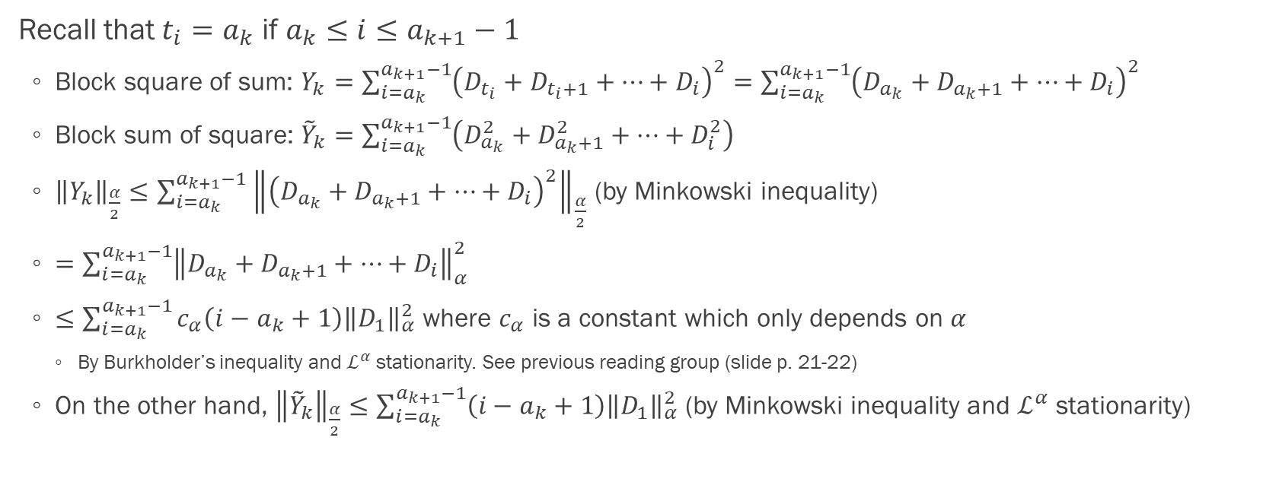

Proof of theorem 1: ${\left\|\frac{Q_{n}}{v_{n}}−σ^{2}\right\|}_{\frac{α}{2}}=o(1)$ (p.14)
Recall that $t_{i}=a_{k}$ if $a_{k}≤i≤a_{k+1}−1$
Block square of sum: $Y_{k}=\sum_{i=a_{k}}^{a_{k+1}−1}{{\left(D_{t_{i}}+D_{t_{i}+1}+…+D_{i}\right)}^{2}}=\sum_{i=a_{k}}^{a_{k+1}−1}{{\left(D_{a_{k}}+D_{a_{k}+1}+…+D_{i}\right)}^{2}}$
Block sum of square: ${\tilde{Y}}_{k}=\sum_{i=a_{k}}^{a_{k+1}−1}{\left(D_{a_{k}}^{2}+D_{a_{k}+1}^{2}+…+D_{i}^{2}\right)}$
${\left\|Y_{k}\right\|}_{\frac{α}{2}}≤\sum_{i=a_{k}}^{a_{k+1}−1}{{\left\|{\left(D_{a_{k}}+D_{a_{k}+1}+…+D_{i}\right)}^{2}\right\|}_{\frac{α}{2}}}$ (by Minkowski inequality)
$=\sum_{i=a_{k}}^{a_{k+1}−1}{{\left\|D_{a_{k}}+D_{a_{k}+1}+…+D_{i}\right\|}_{α}^{2}}$
$≤\sum_{i=a_{k}}^{a_{k+1}−1}{c_{α}\left(i−a_{k}+1\right){\left\|D_{1}\right\|}_{α}^{2}}$ where $c_{α}$ is a constant which only depends on $α$
By Burkholder’s inequality and $ℒ^{α}$ stationarity. See previous reading group (slide p. 21-22)
On the other hand, ${\left\|{\tilde{Y}}_{k}\right\|}_{\frac{α}{2}}≤\sum_{i=a_{k}}^{a_{k+1}−1}{\left(i−a_{k}+1\right){\left\|D_{1}\right\|}_{α}^{2}}$ (by Minkowski inequality and $ℒ^{α}$ stationarity)

Slide 20
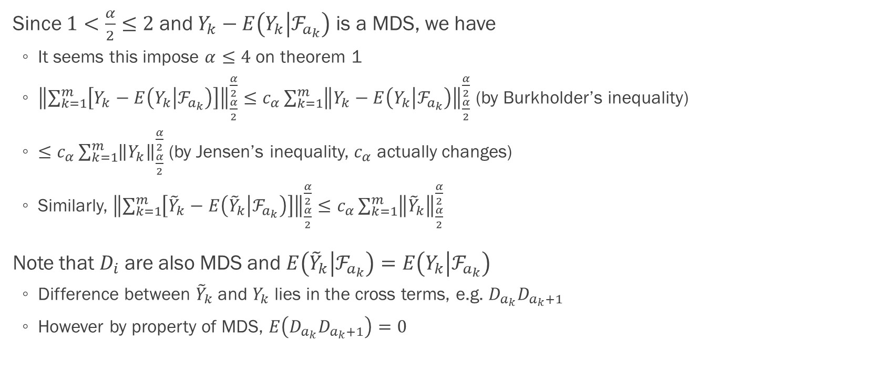
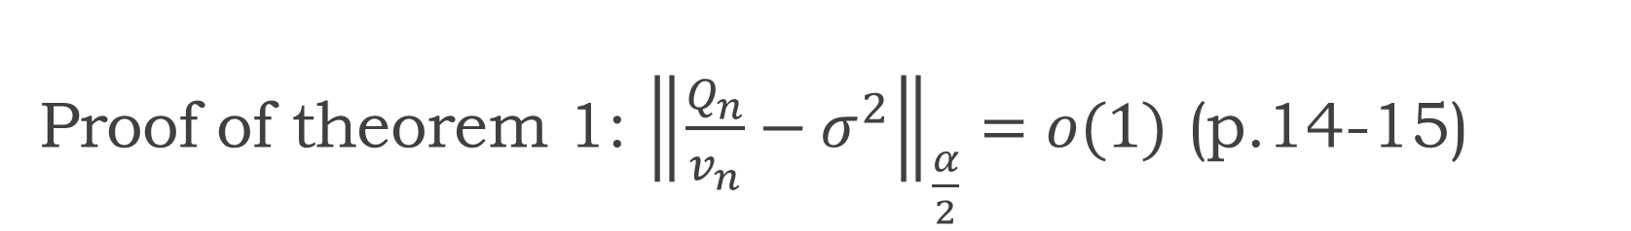
Proof of theorem 1: ${\left\|\frac{Q_{n}}{v_{n}}−σ^{2}\right\|}_{\frac{α}{2}}=o(1)$ (p.14-15)
Since $1<\frac{α}{2}≤2$ and $Y_{k}−E\left(Y_{k} | ℱ_{a_{k}}\right)$ is a MDS, we have
It seems this impose $α≤4$ on theorem 1
${\left\|\sum_{k=1}^{m}{\left[Y_{k}−E\left(Y_{k} | ℱ_{a_{k}}\right)\right]}\right\|}_{\frac{α}{2}}^{\frac{α}{2}}≤c_{α}\sum_{k=1}^{m}{{\left\|Y_{k}−E\left(Y_{k} | ℱ_{a_{k}}\right)\right\|}_{\frac{α}{2}}^{\frac{α}{2}}}$ (by Burkholder’s inequality)
$≤c_{α}\sum_{k=1}^{m}{{\left\|Y_{k}\right\|}_{\frac{α}{2}}^{\frac{α}{2}}}$ (by Jensen’s inequality, $c_{α}$ actually changes)
Similarly, ${\left\|\sum_{k=1}^{m}{\left[{\tilde{Y}}_{k}−E\left({\tilde{Y}}_{k} | ℱ_{a_{k}}\right)\right]}\right\|}_{\frac{α}{2}}^{\frac{α}{2}}≤c_{α}\sum_{k=1}^{m}{{\left\|{\tilde{Y}}_{k}\right\|}_{\frac{α}{2}}^{\frac{α}{2}}}$
Note that $D_{i}$ are also MDS and $E\left({\tilde{Y}}_{k} | ℱ_{a_{k}}\right)=E\left(Y_{k} | ℱ_{a_{k}}\right)$
Difference between ${\tilde{Y}}_{k}$ and $Y_{k}$ lies in the cross terms, e.g. $D_{a_{k}}D_{a_{k}+1}$
However by property of MDS, $E\left(D_{a_{k}}D_{a_{k}+1}\right)=0$

Slide 21
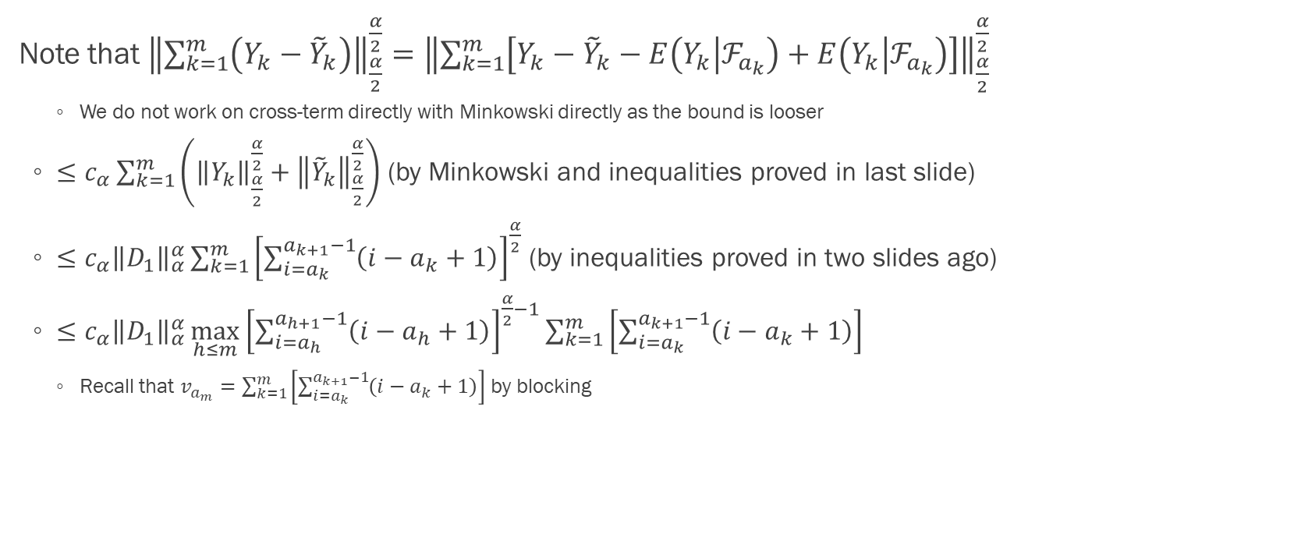

Proof of theorem 1: ${\left\|\frac{Q_{n}}{v_{n}}−σ^{2}\right\|}_{\frac{α}{2}}=o(1)$ (p.15)
Note that ${\left\|\sum_{k=1}^{m}{\left(Y_{k}−{\tilde{Y}}_{k}\right)}\right\|}_{\frac{α}{2}}^{\frac{α}{2}}={\left\|\sum_{k=1}^{m}{\left[Y_{k}−{\tilde{Y}}_{k}−E\left(Y_{k} | ℱ_{a_{k}}\right)+E\left(Y_{k} | ℱ_{a_{k}}\right)\right]}\right\|}_{\frac{α}{2}}^{\frac{α}{2}}$
We do not work on cross-term directly with Minkowski directly as the bound is looser
$≤$ $c_{α}\sum_{k=1}^{m}{\left({\left\|Y_{k}\right\|}_{\frac{α}{2}}^{\frac{α}{2}}+{\left\|{\tilde{Y}}_{k}\right\|}_{\frac{α}{2}}^{\frac{α}{2}}\right)}$ (by Minkowski and inequalities proved in last slide)
$≤c_{α}{\left\|D_{1}\right\|}_{α}^{α}\sum_{k=1}^{m}{{\left[\sum_{i=a_{k}}^{a_{k+1}−1}{\left(i−a_{k}+1\right)}\right]}^{\frac{α}{2}}}$ (by inequalities proved in two slides ago)
$≤c_{α}{\left\|D_{1}\right\|}_{α}^{α}\max_{h≤m}{{\left[\sum_{i=a_{h}}^{a_{h+1}−1}{\left(i−a_{h}+1\right)}\right]}^{\frac{α}{2}−1}}\sum_{k=1}^{m}{\left[\sum_{i=a_{k}}^{a_{k+1}−1}{\left(i−a_{k}+1\right)}\right]}$
Recall that $v_{a_{m}}=\sum_{k=1}^{m}{\left[\sum_{i=a_{k}}^{a_{k+1}−1}{\left(i−a_{k}+1\right)}\right]}$ by blocking

Slide 22
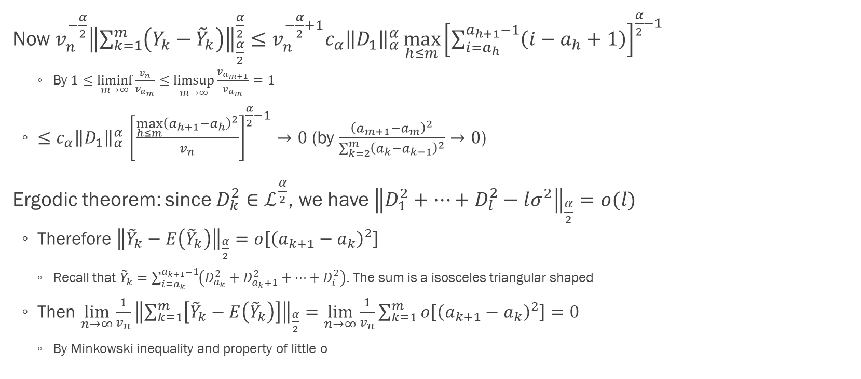
Proof of theorem 1: ${\left\|\frac{Q_{n}}{v_{n}}−σ^{2}\right\|}_{\frac{α}{2}}=o(1)$ (p.15)
Now $v_{n}^{−\frac{α}{2}}{\left\|\sum_{k=1}^{m}{\left(Y_{k}−{\tilde{Y}}_{k}\right)}\right\|}_{\frac{α}{2}}^{\frac{α}{2}}≤v_{n}^{−\frac{α}{2}+1}c_{α}{\left\|D_{1}\right\|}_{α}^{α}\max_{h≤m}{{\left[\sum_{i=a_{h}}^{a_{h+1}−1}{\left(i−a_{h}+1\right)}\right]}^{\frac{α}{2}−1}}$
By $1≤\underset{m→∞}{liminf}{\frac{v_{n}}{v_{a_{m}}}}≤\underset{m→∞}{limsup}{\frac{v_{a_{m+1}}}{v_{a_{m}}}}=1$
${≤c_{α}\left\|D_{1}\right\|}_{α}^{α}{\left[\frac{\max_{h≤m}{{\left(a_{h+1}−a_{h}\right)}^{2}}}{v_{n}}\right]}^{\frac{α}{2}−1}→0$ (by $\frac{{\left(a_{m+1}−a_{m}\right)}^{2}}{\sum_{k=2}^{m}{{\left(a_{k}−a_{k−1}\right)}^{2}}}→0$)
Ergodic theorem: since $D_{k}^{2}∈ℒ^{\frac{α}{2}}$, we have ${\left\|D_{1}^{2}+…+D_{l}^{2}−lσ^{2}\right\|}_{\frac{α}{2}}=o(l)$
Therefore ${\left\|{\tilde{Y}}_{k}−E\left({\tilde{Y}}_{k}\right)\right\|}_{\frac{α}{2}}=o\left[{\left(a_{k+1}−a_{k}\right)}^{2}\right]$
Recall that ${\tilde{Y}}_{k}=\sum_{i=a_{k}}^{a_{k+1}−1}{\left(D_{a_{k}}^{2}+D_{a_{k}+1}^{2}+…+D_{i}^{2}\right)}$. The sum is a isosceles triangular shaped
Then $\lim_{n→∞}{\frac{1}{v_{n}}{\left\|\sum_{k=1}^{m}{\left[{\tilde{Y}}_{k}−E\left({\tilde{Y}}_{k}\right)\right]}\right\|}_{\frac{α}{2}}}=\lim_{n→∞}{\frac{1}{v_{n}}\sum_{k=1}^{m}{o\left[{\left(a_{k+1}−a_{k}\right)}^{2}\right]}}=0$
By Minkowski inequality and property of little o

Slide 23
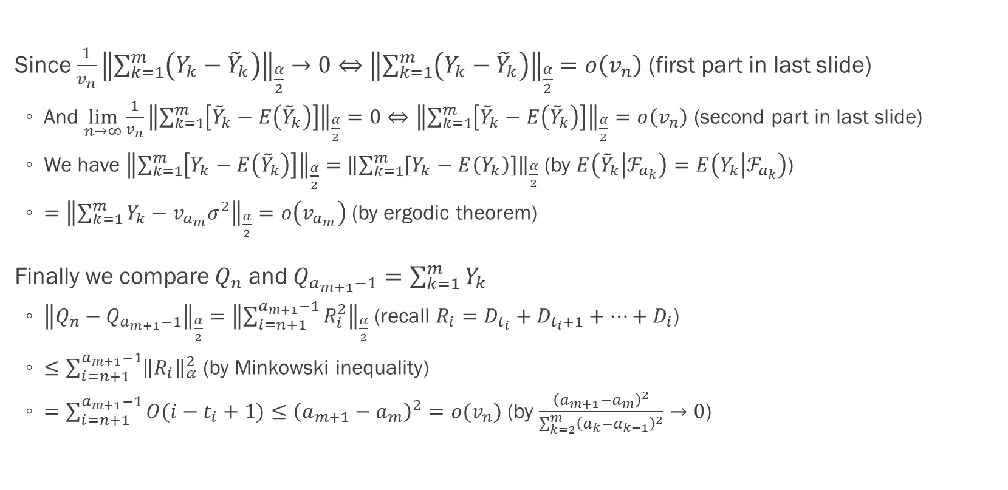
Proof of theorem 1: ${\left\|\frac{Q_{n}}{v_{n}}−σ^{2}\right\|}_{\frac{α}{2}}=o(1)$ (p.15)
Since $\frac{1}{v_{n}}{\left\|\sum_{k=1}^{m}{\left(Y_{k}−{\tilde{Y}}_{k}\right)}\right\|}_{\frac{α}{2}}→0⇔{\left\|\sum_{k=1}^{m}{\left(Y_{k}−{\tilde{Y}}_{k}\right)}\right\|}_{\frac{α}{2}}=o\left(v_{n}\right)$ (first part in last slide)
And $\lim_{n→∞}{\frac{1}{v_{n}}{\left\|\sum_{k=1}^{m}{\left[{\tilde{Y}}_{k}−E\left({\tilde{Y}}_{k}\right)\right]}\right\|}_{\frac{α}{2}}}=0⇔{\left\|\sum_{k=1}^{m}{\left[{\tilde{Y}}_{k}−E\left({\tilde{Y}}_{k}\right)\right]}\right\|}_{\frac{α}{2}}=o\left(v_{n}\right)$ (second part in last slide)
We have ${\left\|\sum_{k=1}^{m}{\left[Y_{k}−E\left({\tilde{Y}}_{k}\right)\right]}\right\|}_{\frac{α}{2}}=$ ${\left\|\sum_{k=1}^{m}{\left[Y_{k}−E\left(Y_{k}\right)\right]}\right\|}_{\frac{α}{2}}$ (by $E\left({\tilde{Y}}_{k} | ℱ_{a_{k}}\right)=E\left(Y_{k} | ℱ_{a_{k}}\right)$)
$={\left\|\sum_{k=1}^{m}{Y_{k}}−v_{a_{m}}σ^{2}\right\|}_{\frac{α}{2}}=o\left(v_{a_{m}}\right)$ (by ergodic theorem)
Finally we compare $Q_{n}$ and $Q_{a_{m+1}−1}=\sum_{k=1}^{m}{Y_{k}}$
${\left\|Q_{n}−Q_{a_{m+1}−1}\right\|}_{\frac{α}{2}}={\left\|\sum_{i=n+1}^{a_{m+1}−1}{R_{i}^{2}}\right\|}_{\frac{α}{2}}$ (recall $R_{i}=D_{t_{i}}+D_{t_{i}+1}+…+D_{i}$)
$≤\sum_{i=n+1}^{a_{m+1}−1}{{\left\|R_{i}\right\|}_{α}^{2}}$ (by Minkowski inequality)
$=\sum_{i=n+1}^{a_{m+1}−1}{O(i−t_{i}+1)}≤{\left(a_{m+1}−a_{m}\right)}^{2}=o(v_{n})$ (by $\frac{{\left(a_{m+1}−a_{m}\right)}^{2}}{\sum_{k=2}^{m}{{\left(a_{k}−a_{k−1}\right)}^{2}}}→0$)

Slide 24
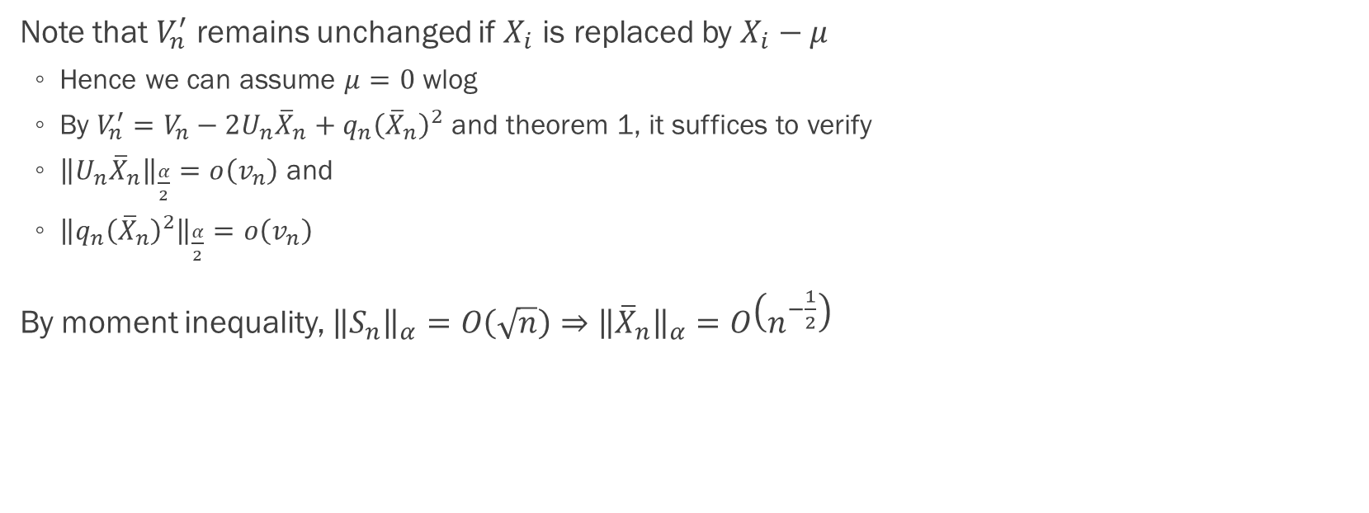
Proof of corollary 1: requirement (p.15)
Note that $V_{n}^{′}$ remains unchanged if $X_{i}$ is replaced by $X_{i}−μ$
Hence we can assume $μ=0$ wlog
By $V_{n}^{′}=V_{n}−2U_{n}{\overline{X}}_{n}+q_{n}{\left({\overline{X}}_{n}\right)}^{2}$ and theorem 1, it suffices to verify
${\left\|U_{n}{\overline{X}}_{n}\right\|}_{\frac{α}{2}}=o\left(v_{n}\right)$ and
${\left\|q_{n}{\left({\overline{X}}_{n}\right)}^{2}\right\|}_{\frac{α}{2}}=o\left(v_{n}\right)$
By moment inequality, ${\left\|S_{n}\right\|}_{α}=O\left(\sqrt{n}\right)⇒{\left\|{\overline{X}}_{n}\right\|}_{α}=O\left(n^{−\frac{1}{2}}\right)$

Slide 25
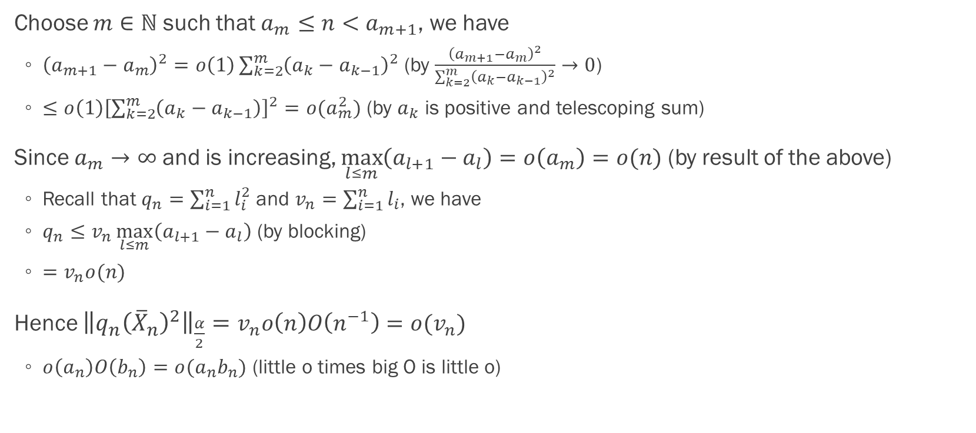
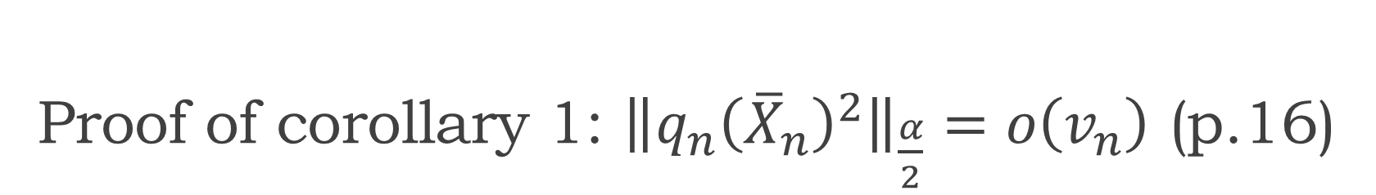
Proof of corollary 1: ${\left\|q_{n}{\left({\overline{X}}_{n}\right)}^{2}\right\|}_{\frac{α}{2}}=o\left(v_{n}\right)$ (p.16)
Choose $m∈ℕ$ such that $a_{m}≤n<a_{m+1}$, we have
${\left(a_{m+1}−a_{m}\right)}^{2}=o\left(1\right)\sum_{k=2}^{m}{{\left(a_{k}−a_{k−1}\right)}^{2}}$ (by $\frac{{\left(a_{m+1}−a_{m}\right)}^{2}}{\sum_{k=2}^{m}{{\left(a_{k}−a_{k−1}\right)}^{2}}}→0$)
$≤o\left(1\right){\left[\sum_{k=2}^{m}{\left(a_{k}−a_{k−1}\right)}\right]}^{2}=o(a_{m}^{2})$ (by $a_{k}$ is positive and telescoping sum)
Since $a_{m}→∞$ and is increasing, $\max_{l≤m}\left(a_{l+1}−a_{l}\right)=o\left(a_{m}\right)=o(n)$ (by result of the above)
Recall that $q_{n}=\sum_{i=1}^{n}{l_{i}^{2}}$ and $v_{n}=\sum_{i=1}^{n}{l_{i}}$, we have
$q_{n}≤v_{n}\max_{l≤m}\left(a_{l+1}−a_{l}\right)$ (by blocking)
$=v_{n}o(n)$
Hence ${\left\|q_{n}{\left({\overline{X}}_{n}\right)}^{2}\right\|}_{\frac{α}{2}}=v_{n}o\left(n\right)O\left(n^{−1}\right)=o(v_{n})$
$o\left(a_{n}\right)O\left(b_{n}\right)=o(a_{n}b_{n})$ (little o times big O is little o)

Slide 26
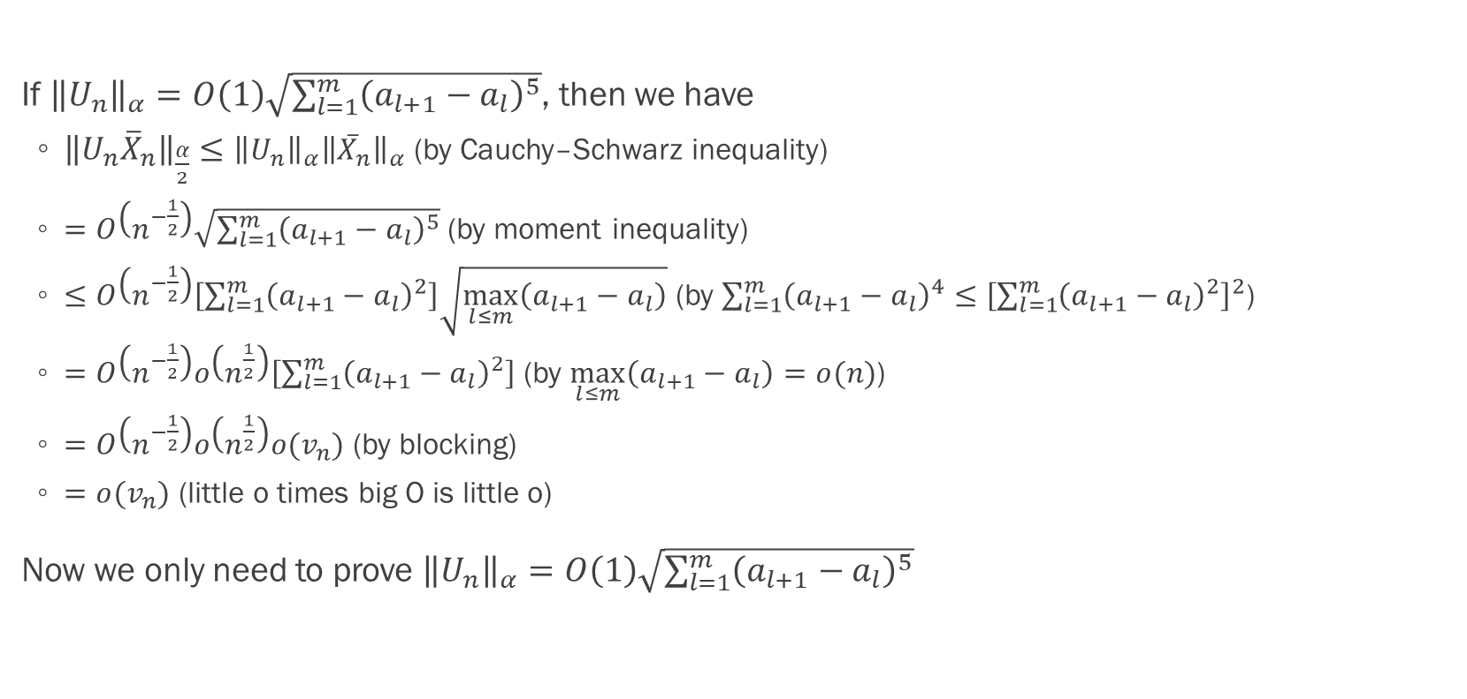

Proof of corollary 1: ${\left\|U_{n}{\overline{X}}_{n}\right\|}_{\frac{α}{2}}=o\left(v_{n}\right)$ (p.16)
If ${\left\|U_{n}\right\|}_{α}=O\left(1\right)\sqrt{\sum_{l=1}^{m}{{\left(a_{l+1}−a_{l}\right)}^{5}}}$, then we have
${\left\|U_{n}{\overline{X}}_{n}\right\|}_{\frac{α}{2}}≤{\left\|U_{n}\right\|}_{α}{\left\|{\overline{X}}_{n}\right\|}_{α}$ (by Cauchy–Schwarz inequality)
$=$ $O\left(n^{−\frac{1}{2}}\right)\sqrt{\sum_{l=1}^{m}{{\left(a_{l+1}−a_{l}\right)}^{5}}}$ (by moment inequality)
$≤O\left(n^{−\frac{1}{2}}\right)\left[\sum_{l=1}^{m}{{\left(a_{l+1}−a_{l}\right)}^{2}}\right]\sqrt{\max_{l≤m}\left(a_{l+1}−a_{l}\right)}$ (by $\sum_{l=1}^{m}{{\left(a_{l+1}−a_{l}\right)}^{4}}≤{\left[\sum_{l=1}^{m}{{\left(a_{l+1}−a_{l}\right)}^{2}}\right]}^{2}$)
$=O\left(n^{−\frac{1}{2}}\right)o\left(n^{\frac{1}{2}}\right)\left[\sum_{l=1}^{m}{{\left(a_{l+1}−a_{l}\right)}^{2}}\right]$ (by $\max_{l≤m}\left(a_{l+1}−a_{l}\right)=o(n)$)
$=O\left(n^{−\frac{1}{2}}\right)o\left(n^{\frac{1}{2}}\right)o(v_{n})$ (by blocking)
$=o(v_{n})$ (little o times big O is little o)
Now we only need to prove ${\left\|U_{n}\right\|}_{α}=O\left(1\right)\sqrt{\sum_{l=1}^{m}{{\left(a_{l+1}−a_{l}\right)}^{5}}}$

Slide 27
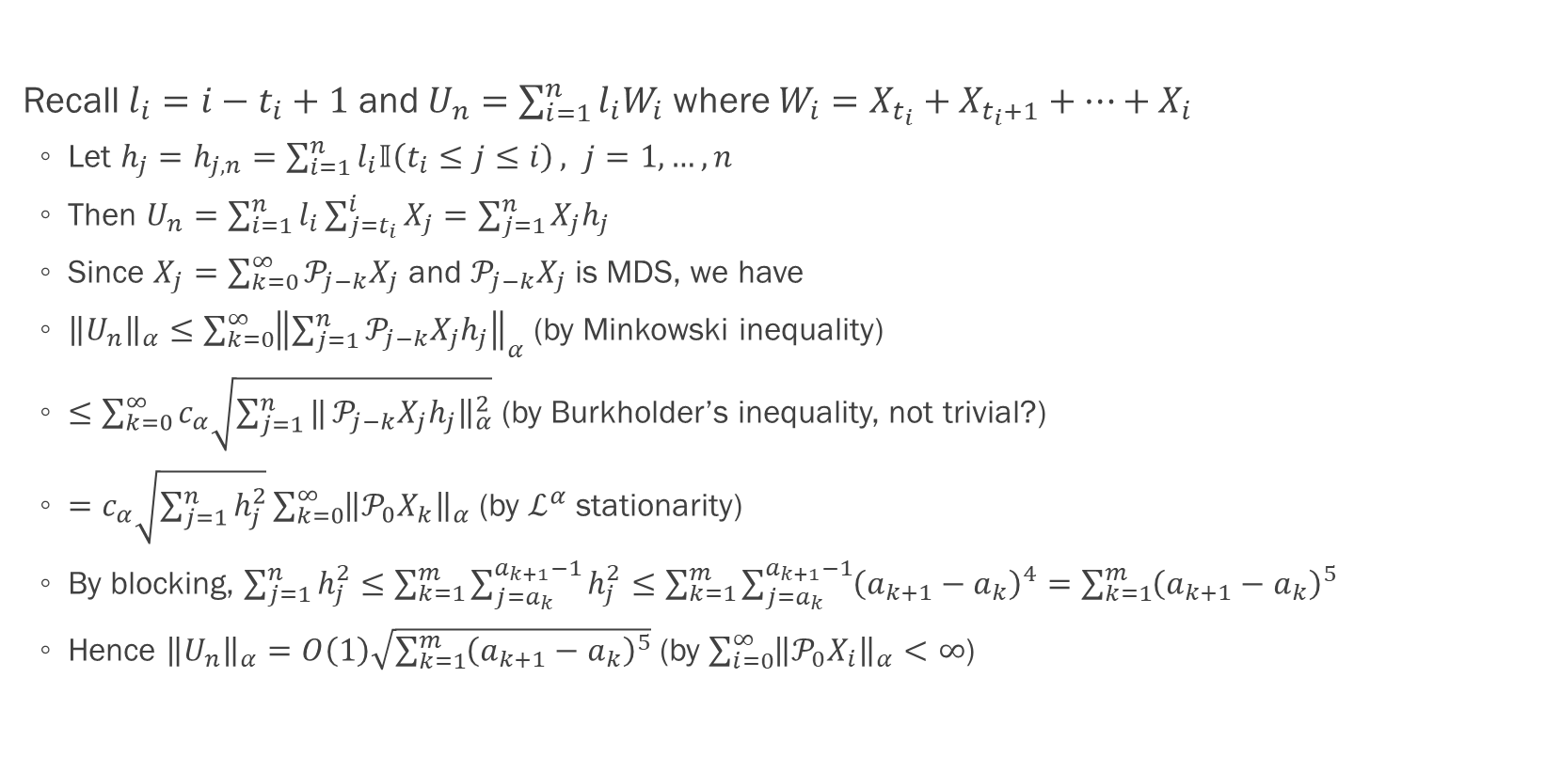
Proof of corollary 1: ${\left\|U_{n}{\overline{X}}_{n}\right\|}_{\frac{α}{2}}=o\left(v_{n}\right)$ (p.16)
Recall $l_{i}=i−t_{i}+1$ and $U_{n}=\sum_{i=1}^{n}{l_{i}W_{i}}$ where $W_{i}=X_{t_{i}}+X_{t_{i}+1}+…+X_{i}$
Let $h_{j}=h_{j,n}=\sum_{i=1}^{n}{l_{i}𝕀\left(t_{i}≤j≤i\right)}, j=1,…,n$
Then $U_{n}=\sum_{i=1}^{n}{l_{i}\sum_{j=t_{i}}^{i}{X_{j}}}=\sum_{j=1}^{n}{X_{j}h_{j}}$
Since $X_{j}=\sum_{k=0}^{∞}{𝒫_{j−k}X_{j}}$ and $𝒫_{j−k}X_{j}$ is MDS, we have
${\left\|U_{n}\right\|}_{α}≤\sum_{k=0}^{∞}{{\left\|\sum_{j=1}^{n}{𝒫_{j−k}X_{j}h_{j}}\right\|}_{α}}$ (by Minkowski inequality)
$≤\sum_{k=0}^{∞}{c_{α}\sqrt{\sum_{j=1}^{n}{‖}𝒫_{j−k}X_{j}h_{j}{\left.​\right\|}_{α}^{2}}}$ (by Burkholder’s inequality, not trivial?)
$=c_{α}\sqrt{\sum_{j=1}^{n}{h_{j}^{2}}}\sum_{k=0}^{∞}{{\left\|𝒫_{0}X_{k}\right\|}_{α}}$ (by $ℒ^{α}$ stationarity)
By blocking, $\sum_{j=1}^{n}{h_{j}^{2}}≤\sum_{k=1}^{m}{\sum_{j=a_{k}}^{a_{k+1}−1}{h_{j}^{2}}}≤\sum_{k=1}^{m}{\sum_{j=a_{k}}^{a_{k+1}−1}{{\left(a_{k+1}−a_{k}\right)}^{4}}}=\sum_{k=1}^{m}{{\left(a_{k+1}−a_{k}\right)}^{5}}$
Hence ${\left\|U_{n}\right\|}_{α}=O\left(1\right)\sqrt{\sum_{k=1}^{m}{{\left(a_{k+1}−a_{k}\right)}^{5}}}$ (by $\sum_{i=0}^{∞}{{\left\|𝒫_{0}X_{i}\right\|}_{α}}<∞$)

Slide 28
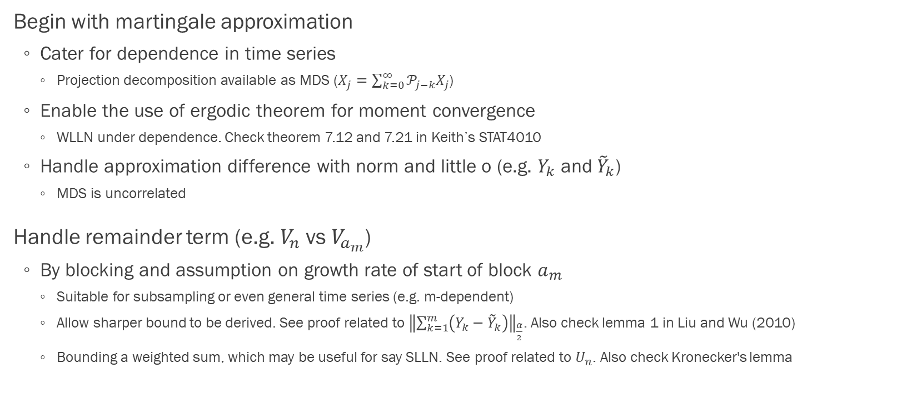
Proof of moment convergence: summary of techniques
Begin with martingale approximation
Cater for dependence in time series
Projection decomposition available as MDS ($X_{j}=\sum_{k=0}^{∞}{𝒫_{j−k}X_{j}}$)
Enable the use of ergodic theorem for moment convergence
WLLN under dependence. Check theorem 7.12 and 7.21 in Keith’s STAT4010
Handle approximation difference with norm and little o (e.g. $Y_{k}$ and ${\tilde{Y}}_{k}$)
MDS is uncorrelated
Handle remainder term (e.g. $V_{n}$ vs $V_{a_{m}}$)
By blocking and assumption on growth rate of start of block $a_{m}$
Suitable for subsampling or even general time series (e.g. m-dependent)
Allow sharper bound to be derived. See proof related to ${\left\|\sum_{k=1}^{m}{\left(Y_{k}−{\tilde{Y}}_{k}\right)}\right\|}_{\frac{α}{2}}$. Also check lemma 1 in Liu and Wu (2010)
Bounding a weighted sum, which may be useful for say SLLN. See proof related to $U_{n}$. Also check Kronecker's lemma

Slide 29
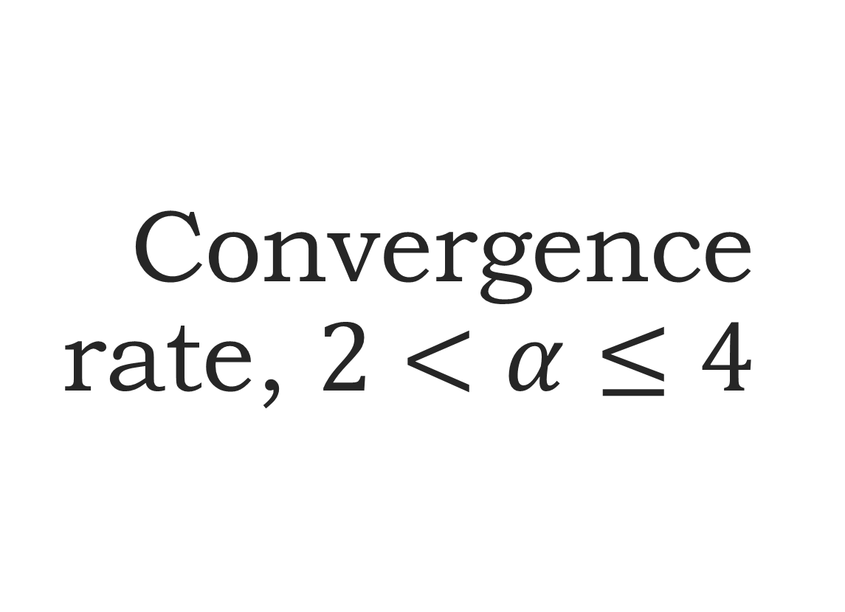
Convergence rate, $2<α≤4$
Section 3.2.1

Slide 30
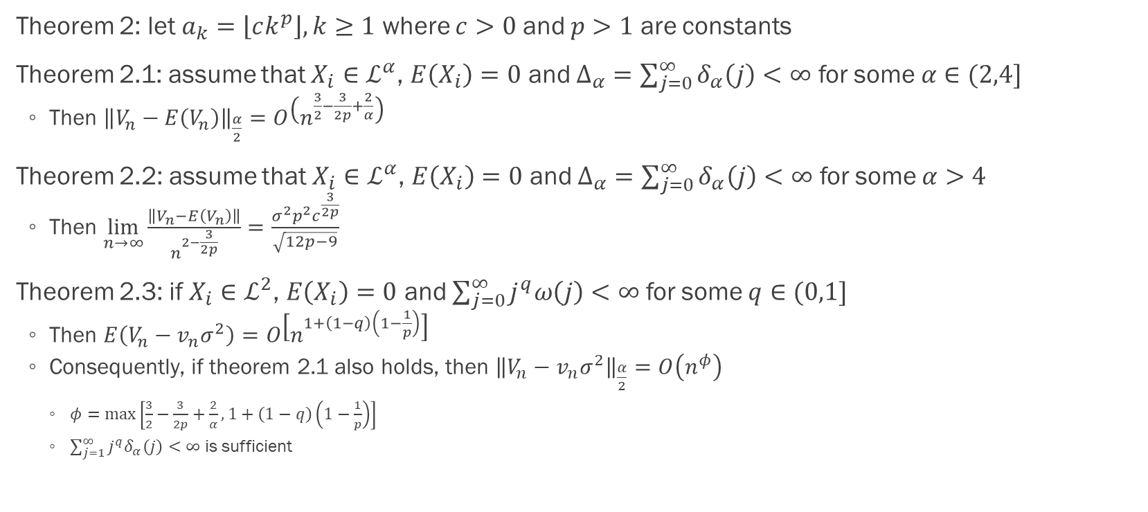
Convergence rate (p.8)
Theorem 2: let $a_{k}=\left\lfloor ck^{p}\right\rfloor , k≥1$ where $c>0$ and $p>1$ are constants
Theorem 2.1: assume that $X_{i}∈ℒ^{α}$, $E\left(X_{i}\right)=0$ and $Δ_{α}=\sum_{j=0}^{∞}{δ_{α}\left(j\right)}<∞$ for some $α∈(2,4]$
Then ${\left\|V_{n}−E\left(V_{n}\right)\right\|}_{\frac{α}{2}}=O\left(n^{\frac{3}{2}−\frac{3}{2p}+\frac{2}{α}}\right)$
Theorem 2.2: assume that $X_{i}∈ℒ^{α}$, $E\left(X_{i}\right)=0$ and $Δ_{α}=\sum_{j=0}^{∞}{δ_{α}\left(j\right)}<∞$ for some $α>4$
Then $\lim_{n→∞}{\frac{\left\|V_{n}−E\left(V_{n}\right)\right\|}{n^{2−\frac{3}{2p}}}}=\frac{σ^{2}p^{2}c^{\frac{3}{2p}}}{\sqrt{12p−9}}$
Theorem 2.3: if $X_{i}∈ℒ^{2}$, $E\left(X_{i}\right)=0$ and $\sum_{j=0}^{∞}{j^{q}ω\left(j\right)}<∞$ for some $q∈(0,1]$
Then $E\left(V_{n}−v_{n}σ^{2}\right)=O\left[n^{1+\left(1−q\right)\left(1−\frac{1}{p}\right)}\right]$
Consequently, if theorem 2.1 also holds, then ${\left\|V_{n}−v_{n}σ^{2}\right\|}_{\frac{α}{2}}=O\left(n^{φ}\right)$
$φ=\max\left[\frac{3}{2}−\frac{3}{2p}+\frac{2}{α}, 1+\left(1−q\right)\left(1−\frac{1}{p}\right)\right]$
$\sum_{j=1}^{∞}{j^{q}δ_{α}\left(j\right)}<∞$ is sufficient

Slide 31
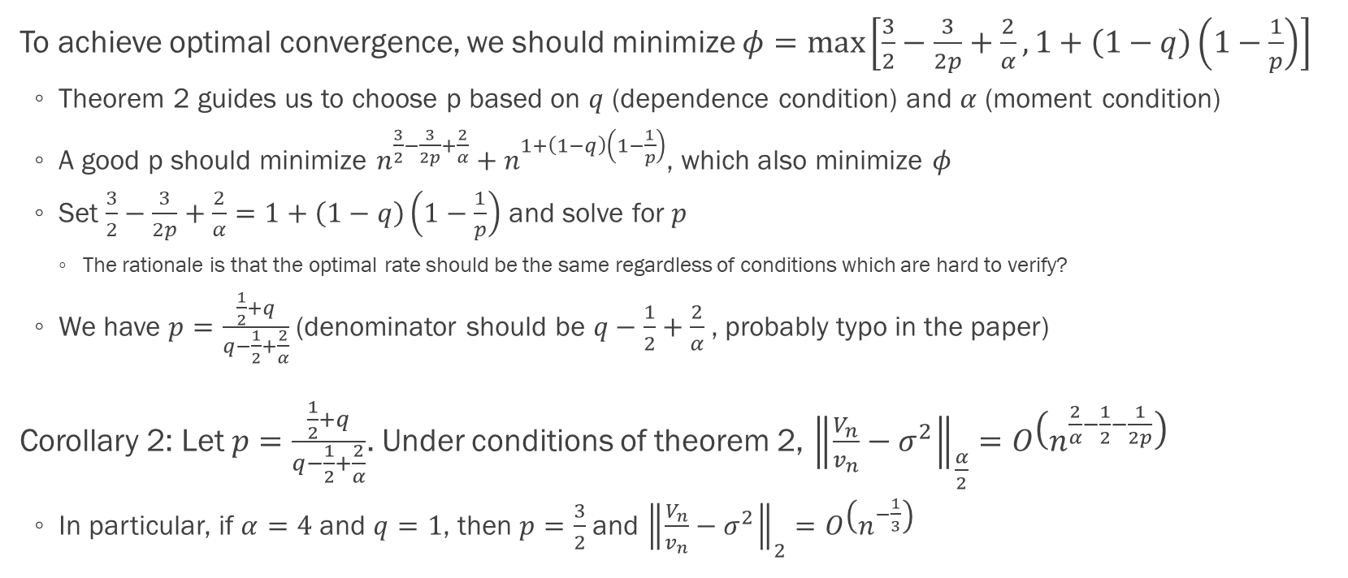
Optimal convergence rate (p.8)
To achieve optimal convergence, we should minimize $φ=\max\left[\frac{3}{2}−\frac{3}{2p}+\frac{2}{α}, 1+\left(1−q\right)\left(1−\frac{1}{p}\right)\right]$
Theorem 2 guides us to choose p based on $q$ (dependence condition) and $α$ (moment condition)
A good p should minimize $n^{\frac{3}{2}−\frac{3}{2p}+\frac{2}{α}}+n^{1+\left(1−q\right)\left(1−\frac{1}{p}\right)}$, which also minimize $φ$
Set $\frac{3}{2}−\frac{3}{2p}+\frac{2}{α}=1+\left(1−q\right)\left(1−\frac{1}{p}\right)$ and solve for $p$
The rationale is that the optimal rate should be the same regardless of conditions which are hard to verify?
We have $p=\frac{\frac{1}{2}+q}{q−\frac{1}{2}+\frac{2}{α}}$ (denominator should be $q−\frac{1}{2}+\frac{2}{α}$, probably typo in the paper)
Corollary 2: Let $p=\frac{\frac{1}{2}+q}{q−\frac{1}{2}+\frac{2}{α}}$. Under conditions of theorem 2, ${\left\|\frac{V_{n}}{v_{n}}−σ^{2}\right\|}_{\frac{α}{2}}=O\left(n^{\frac{2}{α}−\frac{1}{2}−\frac{1}{2p}}\right)$
In particular, if $α=4$ and $q=1$, then $p=\frac{3}{2}$ and ${\left\|\frac{V_{n}}{v_{n}}−σ^{2}\right\|}_{2}=O\left(n^{−\frac{1}{3}}\right)$

Slide 32
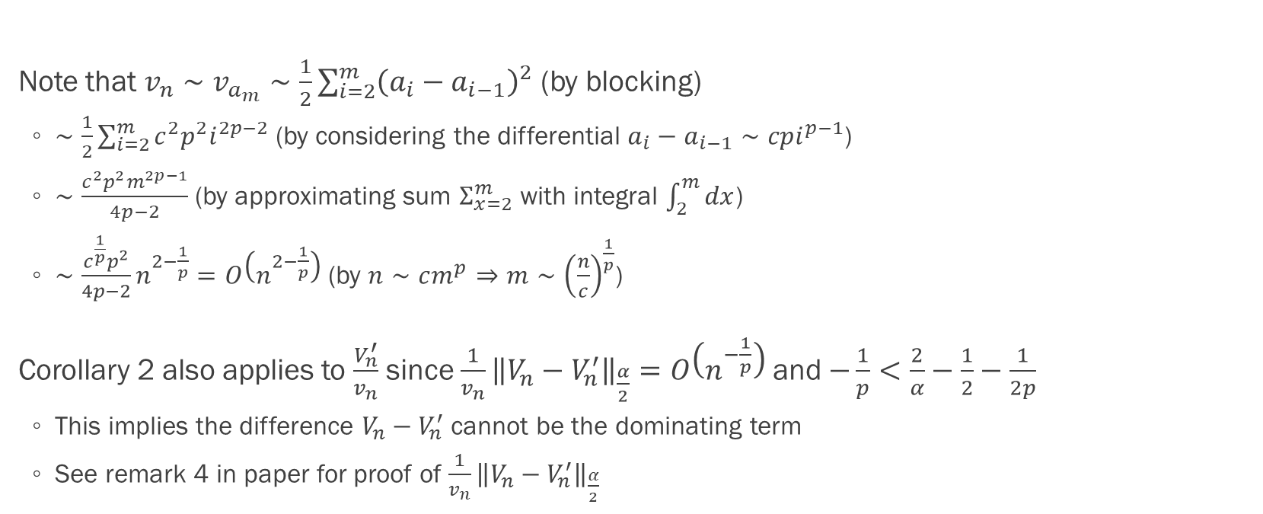
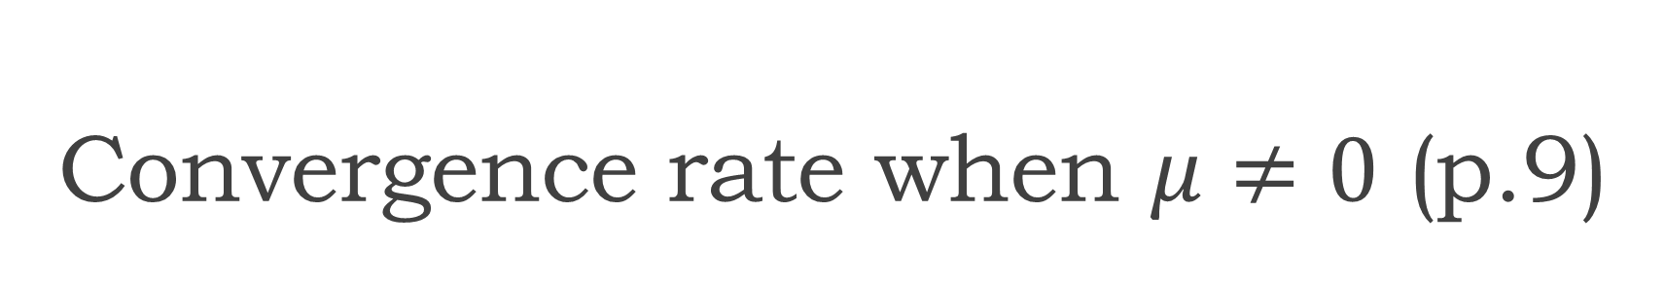
Convergence rate when $μ≠0$ (p.9)
Note that $v_{n}∼v_{a_{m}}∼\frac{1}{2}\sum_{i=2}^{m}{{\left(a_{i}−a_{i−1}\right)}^{2}}$ (by blocking)
$∼\frac{1}{2}\sum_{i=2}^{m}{c^{2}p^{2}i^{2p−2}}$ (by considering the differential $a_{i}−a_{i−1}∼cpi^{p−1}$)
$∼\frac{c^{2}p^{2}m^{2p−1}}{4p−2}$ (by approximating sum $Σ_{x=2}^{m}$ with integral $\int_{2}^{m}{dx}$)
$∼\frac{c^{\frac{1}{p}}p^{2}}{4p−2}n^{2−\frac{1}{p}}=O\left(n^{2−\frac{1}{p}}\right)$ (by $n∼cm^{p}⇒m∼{\left(\frac{n}{c}\right)}^{\frac{1}{p}}$)
Corollary 2 also applies to $\frac{V_{n}^{′}}{v_{n}}$ since $\frac{1}{v_{n}}{\left\|V_{n}−V_{n}^{′}\right\|}_{\frac{α}{2}}=O\left(n^{−\frac{1}{p}}\right)$ and $−\frac{1}{p}<\frac{2}{α}−\frac{1}{2}−\frac{1}{2p}$
This implies the difference $V_{n}−V_{n}^{′}$ cannot be the dominating term
See remark 4 in paper for proof of $\frac{1}{v_{n}}{\left\|V_{n}−V_{n}^{′}\right\|}_{\frac{α}{2}}$

Slide 33
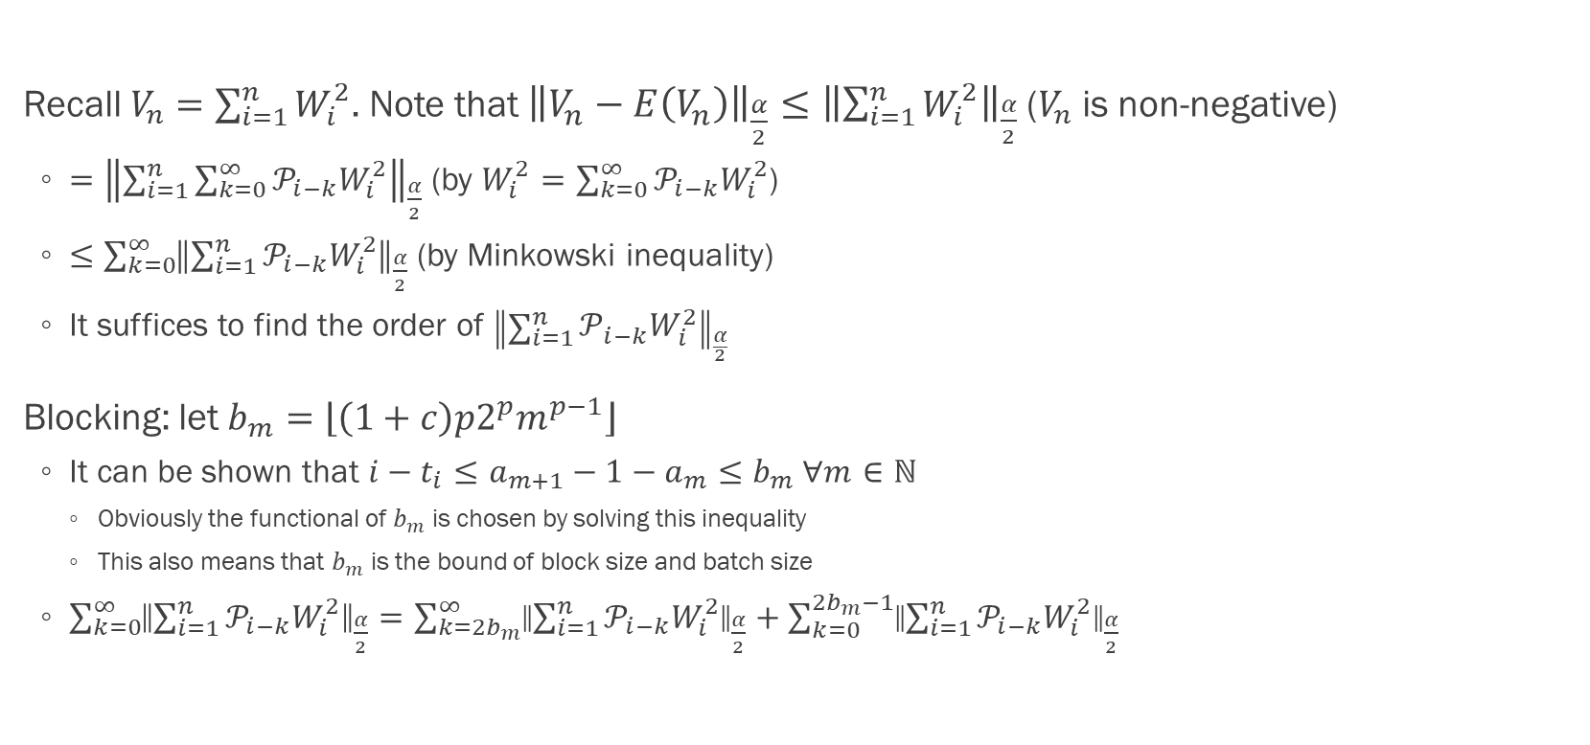
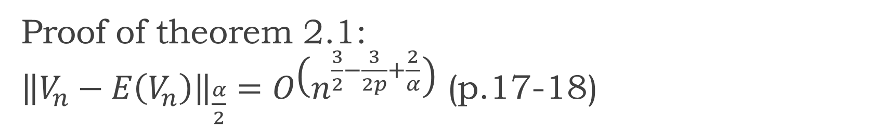
Proof of theorem 2.1: ${\left\|V_{n}−E\left(V_{n}\right)\right\|}_{\frac{α}{2}}=O\left(n^{\frac{3}{2}−\frac{3}{2p}+\frac{2}{α}}\right)$ (p.17-18)
Recall $V_{n}=\sum_{i=1}^{n}{W_{i}^{2}}$. Note that ${\left\|V_{n}−E\left(V_{n}\right)\right\|}_{\frac{α}{2}}≤{\left\|\sum_{i=1}^{n}{W_{i}^{2}}\right\|}_{\frac{α}{2}}$ ($V_{n}$ is non-negative)
$={\left\|\sum_{i=1}^{n}{\sum_{k=0}^{∞}{𝒫_{i−k}W_{i}^{2}}}\right\|}_{\frac{α}{2}}$ (by $W_{i}^{2}=\sum_{k=0}^{∞}{𝒫_{i−k}W_{i}^{2}}$)
$≤\sum_{k=0}^{∞}{{\left\|\sum_{i=1}^{n}{𝒫_{i−k}W_{i}^{2}}\right\|}_{\frac{α}{2}}}$ (by Minkowski inequality)
It suffices to find the order of ${\left\|\sum_{i=1}^{n}{𝒫_{i−k}W_{i}^{2}}\right\|}_{\frac{α}{2}}$
Blocking: let $b_{m}=\left\lfloor \left(1+c\right)p2^{p}m^{p−1}\right\rfloor$
It can be shown that $i−t_{i}≤a_{m+1}−1−a_{m}≤b_{m} ∀m∈ℕ$
Obviously the functional of $b_{m}$ is chosen by solving this inequality
This also means that $b_{m}$ is the bound of block size and batch size
$\sum_{k=0}^{∞}{{\left\|\sum_{i=1}^{n}{𝒫_{i−k}W_{i}^{2}}\right\|}_{\frac{α}{2}}}=\sum_{k=2b_{m}}^{∞}{{\left\|\sum_{i=1}^{n}{𝒫_{i−k}W_{i}^{2}}\right\|}_{\frac{α}{2}}}+\sum_{k=0}^{2b_{m}−1}{{\left\|\sum_{i=1}^{n}{𝒫_{i−k}W_{i}^{2}}\right\|}_{\frac{α}{2}}}$

Slide 34
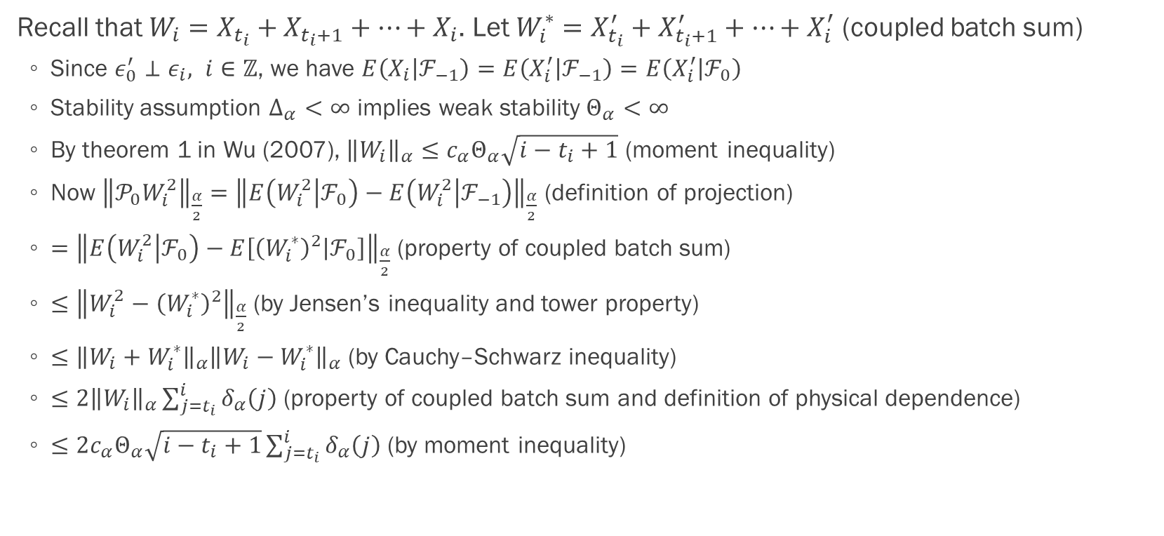
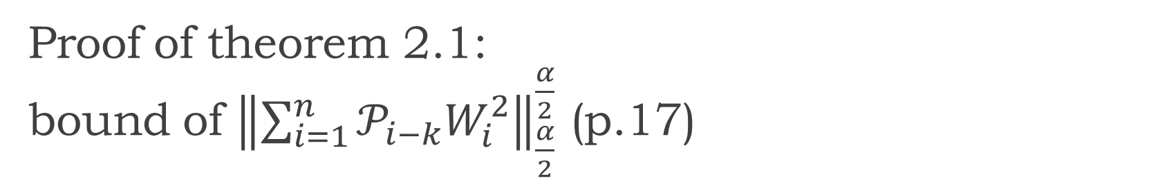
Proof of theorem 2.1: bound of ${\left\|\sum_{i=1}^{n}{𝒫_{i−k}W_{i}^{2}}\right\|}_{\frac{α}{2}}^{\frac{α}{2}}$ (p.17)
Recall that $W_{i}=X_{t_{i}}+X_{t_{i}+1}+…+X_{i}$. Let $W_{i}^{∗}=X_{t_{i}}^{′}+X_{t_{i}+1}^{′}+…+X_{i}^{′}$ (coupled batch sum)
Since $ε_{0}^{′}⊥ε_{i}, i∈ℤ$, we have $E\left(X_{i} | ℱ_{−1}\right)=E\left(X_{i}^{′} | ℱ_{−1}\right)=E\left(X_{i}^{′} | ℱ_{0}\right)$
Stability assumption $Δ_{α}<∞$ implies weak stability $Θ_{α}<∞$
By theorem 1 in Wu (2007), ${\left\|W_{i}\right\|}_{α}≤c_{α}Θ_{α}\sqrt{i−t_{i}+1}$ (moment inequality)
Now ${\left\|𝒫_{0}W_{i}^{2}\right\|}_{\frac{α}{2}}={\left\|E\left(W_{i}^{2} | ℱ_{0}\right)−E\left(W_{i}^{2} | ℱ_{−1}\right)\right\|}_{\frac{α}{2}}$ (definition of projection)
$={\left\|E\left(W_{i}^{2} | ℱ_{0}\right)−E\left[{\left(W_{i}^{∗}\right)}^{2} | ℱ_{0}\right]\right\|}_{\frac{α}{2}}$ (property of coupled batch sum)
$≤{\left\|W_{i}^{2}−{\left(W_{i}^{∗}\right)}^{2}\right\|}_{\frac{α}{2}}$ (by Jensen’s inequality and tower property)
$≤{\left\|W_{i}+W_{i}^{∗}\right\|}_{α}{\left\|W_{i}−W_{i}^{∗}\right\|}_{α}$ (by Cauchy–Schwarz inequality)
$≤2{\left\|W_{i}\right\|}_{α}\sum_{j=t_{i}}^{i}{δ_{α}\left(j\right)}$ (property of coupled batch sum and definition of physical dependence)
$≤2c_{α}Θ_{α}\sqrt{i−t_{i}+1}\sum_{j=t_{i}}^{i}{δ_{α}\left(j\right)}$ (by moment inequality)

Slide 35
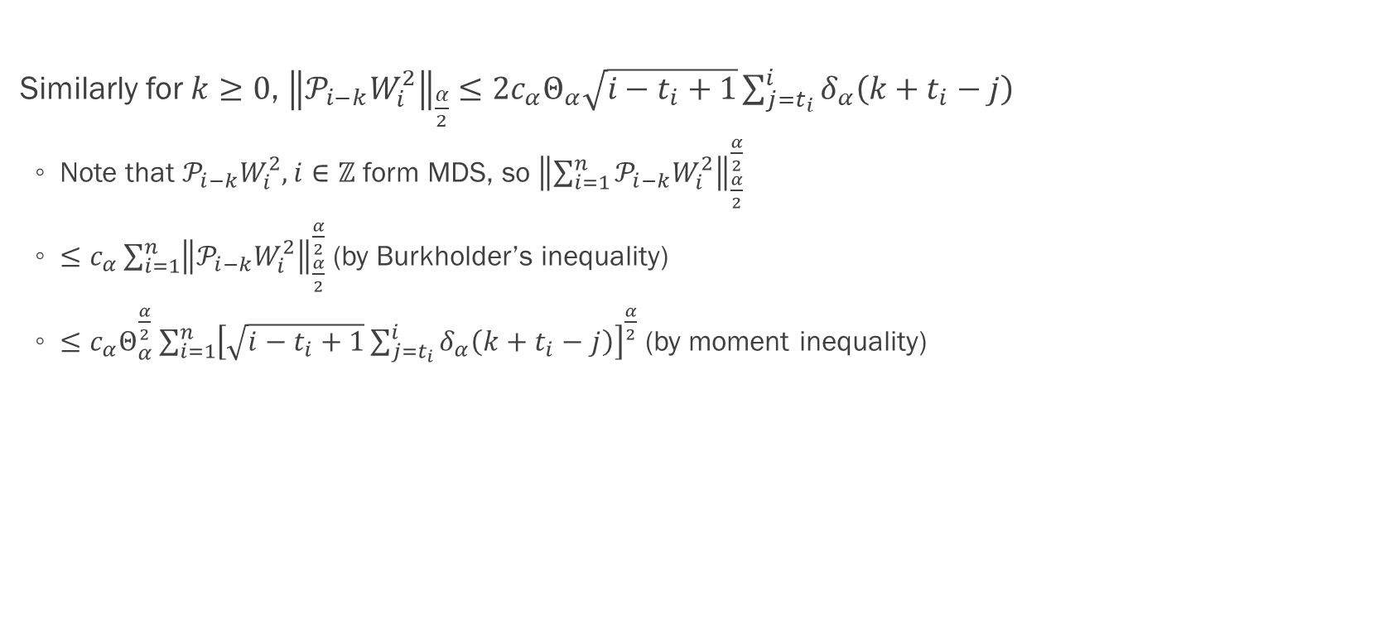
Proof of theorem 2.1: bound of ${\left\|\sum_{i=1}^{n}{𝒫_{i−k}W_{i}^{2}}\right\|}_{\frac{α}{2}}^{\frac{α}{2}}$ (p.17)
Similarly for $k≥0$, ${\left\|𝒫_{i−k}W_{i}^{2}\right\|}_{\frac{α}{2}}≤2c_{α}Θ_{α}\sqrt{i−t_{i}+1}\sum_{j=t_{i}}^{i}{δ_{α}\left(k+t_{i}−j\right)}$
Note that $𝒫_{i−k}W_{i}^{2}, i∈ℤ$ form MDS, so ${\left\|\sum_{i=1}^{n}{𝒫_{i−k}W_{i}^{2}}\right\|}_{\frac{α}{2}}^{\frac{α}{2}}$
$≤c_{α}\sum_{i=1}^{n}{{\left\|𝒫_{i−k}W_{i}^{2}\right\|}_{\frac{α}{2}}^{\frac{α}{2}}}$ (by Burkholder’s inequality)
$≤c_{α}Θ_{α}^{\frac{α}{2}}\sum_{i=1}^{n}{{\left[\sqrt{i−t_{i}+1}\sum_{j=t_{i}}^{i}{δ_{α}\left(k+t_{i}−j\right)}\right]}^{\frac{α}{2}}}$ (by moment inequality)

Slide 36
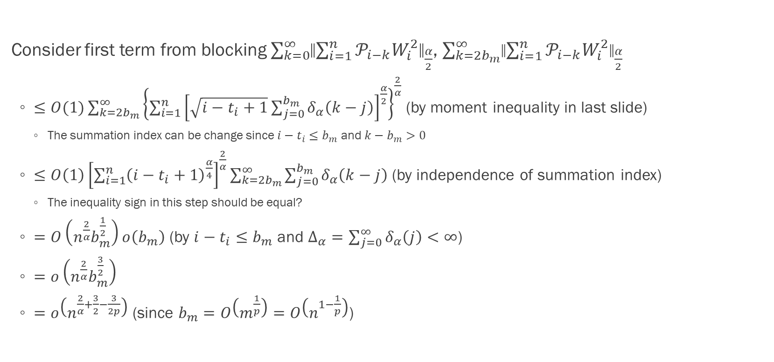
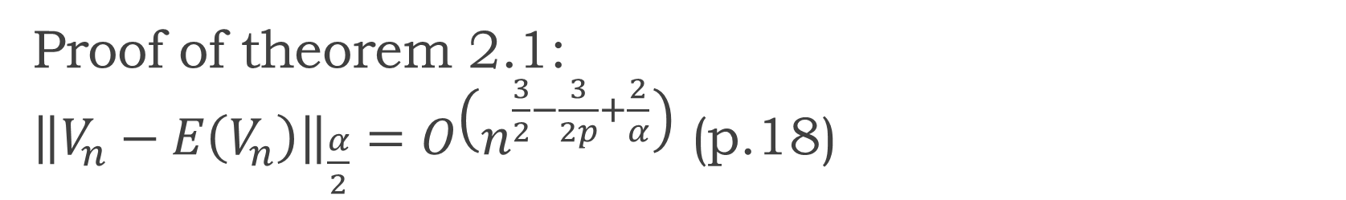
Proof of theorem 2.1: ${\left\|V_{n}−E\left(V_{n}\right)\right\|}_{\frac{α}{2}}=O\left(n^{\frac{3}{2}−\frac{3}{2p}+\frac{2}{α}}\right)$ (p.18)
Consider first term from blocking $\sum_{k=0}^{∞}{{\left\|\sum_{i=1}^{n}{𝒫_{i−k}W_{i}^{2}}\right\|}_{\frac{α}{2}}}$, $\sum_{k=2b_{m}}^{∞}{{\left\|\sum_{i=1}^{n}{𝒫_{i−k}W_{i}^{2}}\right\|}_{\frac{α}{2}}}$
$≤O(1)\sum_{k=2b_{m}}^{∞}{{\left\{\sum_{i=1}^{n}{{\left[\sqrt{i−t_{i}+1}\sum_{j=0}^{b_{m}}{δ_{α}\left(k−j\right)}\right]}^{\frac{α}{2}}}\right\}}^{\frac{2}{α}}}$ (by moment inequality in last slide)
The summation index can be change since $i−t_{i}≤b_{m}$ and $k−b_{m}>0$
$≤O\left(1\right){\left[\sum_{i=1}^{n}{{\left(i−t_{i}+1\right)}^{\frac{α}{4}}}\right]}^{\frac{2}{α}}\sum_{k=2b_{m}}^{∞}{\sum_{j=0}^{b_{m}}{δ_{α}\left(k−j\right)}}$ (by independence of summation index)
The inequality sign in this step should be equal?
$=O\left(n^{\frac{2}{α}}b_{m}^{\frac{1}{2}}\right)o\left(b_{m}\right)$ (by $i−t_{i}≤b_{m}$ and $Δ_{α}=\sum_{j=0}^{∞}{δ_{α}\left(j\right)}<∞$)
$=o\left(n^{\frac{2}{α}}b_{m}^{\frac{3}{2}}\right)$
$=o\left(n^{\frac{2}{α}+\frac{3}{2}−\frac{3}{2p}}\right)$ (since $b_{m}=O\left(m^{\frac{1}{p}}\right)=O\left(n^{1−\frac{1}{p}}\right)$)

Slide 37
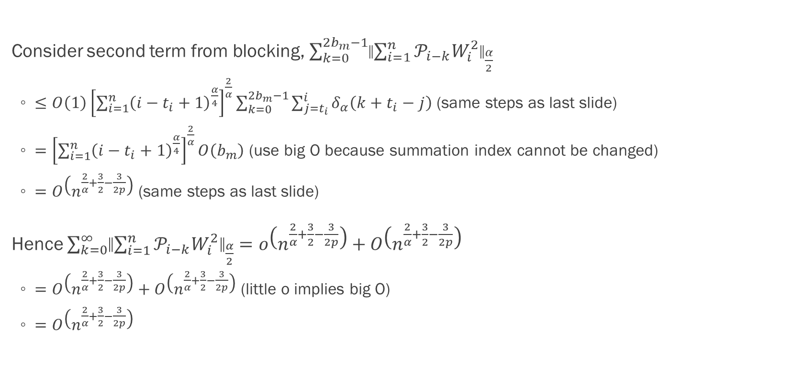
Proof of theorem 2.1: ${\left\|V_{n}−E\left(V_{n}\right)\right\|}_{\frac{α}{2}}=O\left(n^{\frac{3}{2}−\frac{3}{2p}+\frac{2}{α}}\right)$ (p.18)
Consider second term from blocking, $\sum_{k=0}^{2b_{m}−1}{{\left\|\sum_{i=1}^{n}{𝒫_{i−k}W_{i}^{2}}\right\|}_{\frac{α}{2}}}$
$≤O\left(1\right){\left[\sum_{i=1}^{n}{{\left(i−t_{i}+1\right)}^{\frac{α}{4}}}\right]}^{\frac{2}{α}}\sum_{k=0}^{2b_{m}−1}{\sum_{j=t_{i}}^{i}{δ_{α}\left(k+t_{i}−j\right)}}$ (same steps as last slide)
$={\left[\sum_{i=1}^{n}{{\left(i−t_{i}+1\right)}^{\frac{α}{4}}}\right]}^{\frac{2}{α}}O\left(b_{m}\right)$ (use big O because summation index cannot be changed)
$=O\left(n^{\frac{2}{α}+\frac{3}{2}−\frac{3}{2p}}\right)$ (same steps as last slide)
Hence $\sum_{k=0}^{∞}{{\left\|\sum_{i=1}^{n}{𝒫_{i−k}W_{i}^{2}}\right\|}_{\frac{α}{2}}}=o\left(n^{\frac{2}{α}+\frac{3}{2}−\frac{3}{2p}}\right)+O\left(n^{\frac{2}{α}+\frac{3}{2}−\frac{3}{2p}}\right)$
$=O\left(n^{\frac{2}{α}+\frac{3}{2}−\frac{3}{2p}}\right)+O\left(n^{\frac{2}{α}+\frac{3}{2}−\frac{3}{2p}}\right)$ (little o implies big O)
$=O\left(n^{\frac{2}{α}+\frac{3}{2}−\frac{3}{2p}}\right)$

Slide 38
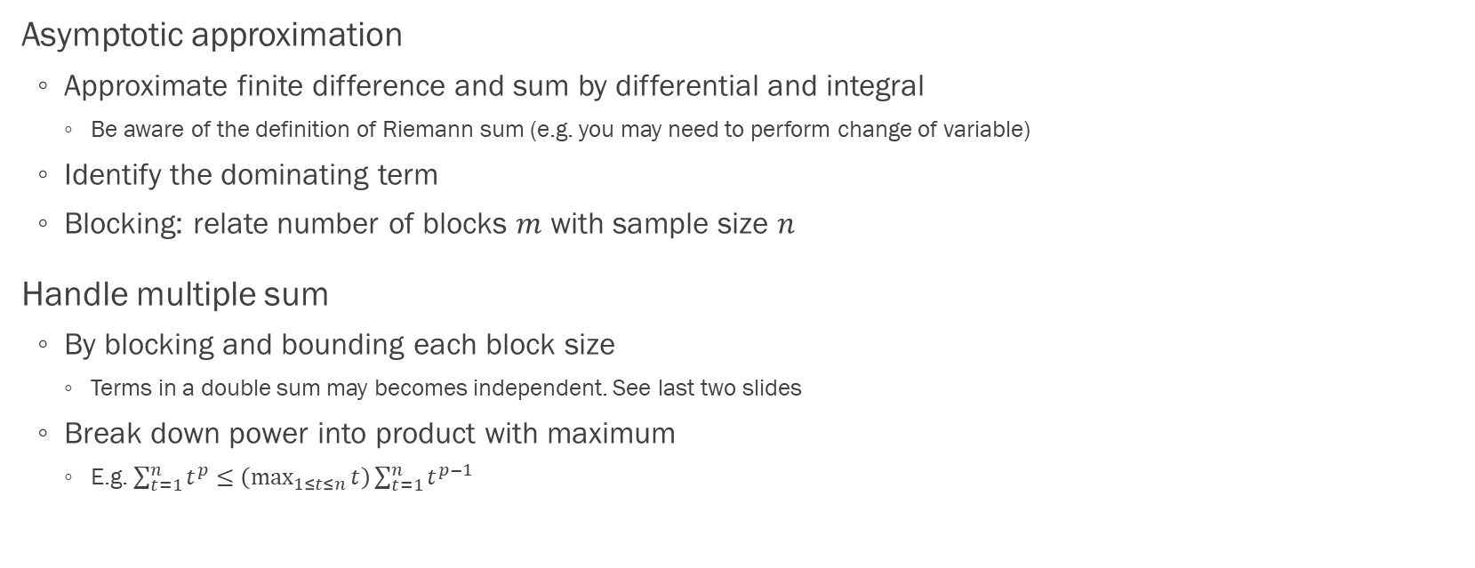
Proof of theorem 2.1: summary of techniques
Asymptotic approximation
Approximate finite difference and sum by differential and integral
Be aware of the definition of Riemann sum (e.g. you may need to perform change of variable)
Identify the dominating term
Blocking: relate number of blocks $m$ with sample size $n$
Handle multiple sum
By blocking and bounding each block size
Terms in a double sum may becomes independent. See last two slides
Break down power into product with maximum
E.g. $\sum_{t=1}^{n}{t^{p}}≤\left(\max_{1≤t≤n}{t}\right)\sum_{t=1}^{n}{t^{p−1}}$

Slide 39
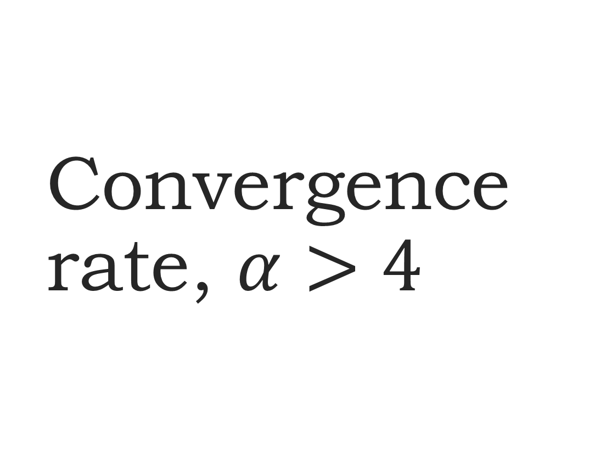
Convergence rate, $α>4$
Section 3.2.2

Slide 40
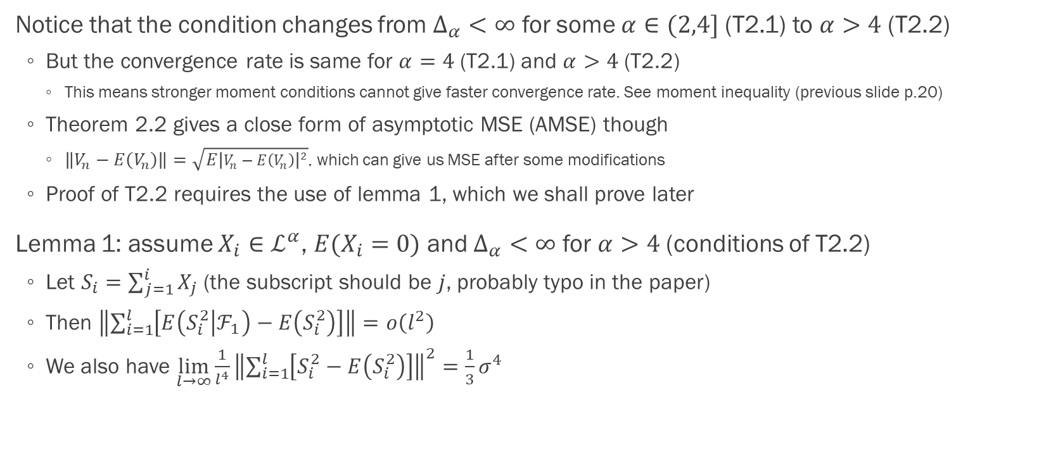

Proof of theorem 2.2: $\lim_{n→∞}{\frac{\left\|V_{n}−E\left(V_{n}\right)\right\|}{n^{2−\frac{3}{2p}}}}=\frac{σ^{2}p^{2}c^{\frac{3}{2p}}}{\sqrt{12p−9}}$ (p.20)
Notice that the condition changes from $Δ_{α}<∞$ for some $α∈(2,4]$ (T2.1) to $α>4$ (T2.2)
But the convergence rate is same for $α=4$ (T2.1) and $α>4$ (T2.2)
This means stronger moment conditions cannot give faster convergence rate. See moment inequality (previous slide p.20)
Theorem 2.2 gives a close form of asymptotic MSE (AMSE) though
$\left\|V_{n}−E\left(V_{n}\right)\right\|=\sqrt{E{\left|V_{n}−E\left(V_{n}\right)\right|}^{2}}$, which can give us MSE after some modifications
Proof of T2.2 requires the use of lemma 1, which we shall prove later
Lemma 1: assume $X_{i}∈ℒ^{α}$, $E(X_{i}=0)$ and $Δ_{α}<∞$ for $α>4$ (conditions of T2.2)
Let $S_{i}=\sum_{j=1}^{i}{X_{j}}$ (the subscript should be $j$, probably typo in the paper)
Then $\left\|\sum_{i=1}^{l}{\left[E\left(S_{i}^{2} | ℱ_{1}\right)−E\left(S_{i}^{2}\right)\right]}\right\|=o\left(l^{2}\right)$
We also have $\lim_{l→∞}{\frac{1}{l^{4}}{\left\|\sum_{i=1}^{l}{\left[S_{i}^{2}−E\left(S_{i}^{2}\right)\right]}\right\|}^{2}}=\frac{1}{3}σ^{4}$

Slide 41
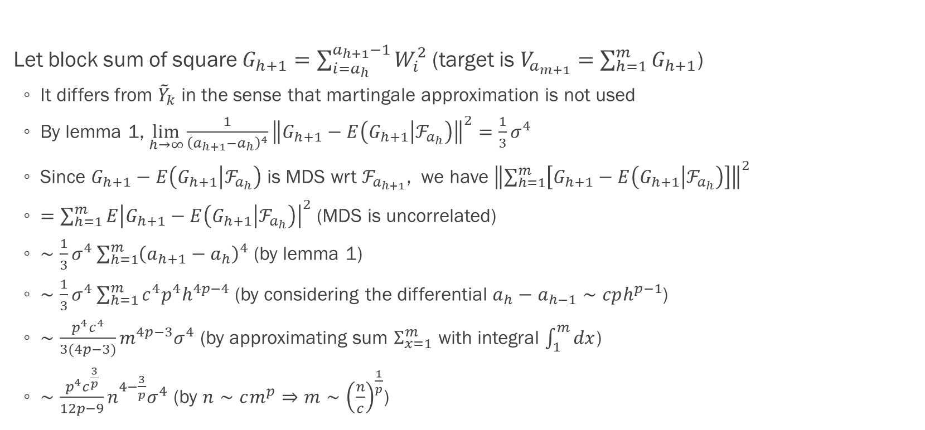
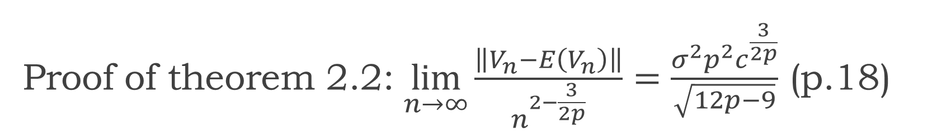
Proof of theorem 2.2: $\lim_{n→∞}{\frac{\left\|V_{n}−E\left(V_{n}\right)\right\|}{n^{2−\frac{3}{2p}}}}=\frac{σ^{2}p^{2}c^{\frac{3}{2p}}}{\sqrt{12p−9}}$ (p.18)
Let block sum of square $G_{h+1}=\sum_{i=a_{h}}^{a_{h+1}−1}{W_{i}^{2}}$ (target is $V_{a_{m+1}}=\sum_{h=1}^{m}{G_{h+1}}$)
It differs from ${\tilde{Y}}_{k}$ in the sense that martingale approximation is not used
By lemma 1, $\lim_{h→∞}{\frac{1}{{\left(a_{h+1}−a_{h}\right)}^{4}}{\left\|G_{h+1}−E\left(G_{h+1} | ℱ_{a_{h}}\right)\right\|}^{2}}=\frac{1}{3}σ^{4}$
Since $G_{h+1}−E\left(G_{h+1} | ℱ_{a_{h}}\right)$ is MDS wrt $ℱ_{a_{h+1}}$, we have ${\left\|\sum_{h=1}^{m}{\left[G_{h+1}−E\left(G_{h+1} | ℱ_{a_{h}}\right)\right]}\right\|}^{2}$
$=\sum_{h=1}^{m}{E{\left|G_{h+1}−E\left(G_{h+1} | ℱ_{a_{h}}\right)\right|}^{2}}$ (MDS is uncorrelated)
$∼\frac{1}{3}σ^{4}\sum_{h=1}^{m}{{\left(a_{h+1}−a_{h}\right)}^{4}}$ (by lemma 1)
$∼\frac{1}{3}σ^{4}\sum_{h=1}^{m}{c^{4}p^{4}h^{4p−4}}$ (by considering the differential $a_{h}−a_{h−1}∼cph^{p−1}$)
$∼\frac{p^{4}c^{4}}{3(4p−3)}m^{4p−3}σ^{4}$ (by approximating sum $Σ_{x=1}^{m}$ with integral $\int_{1}^{m}{dx}$)
$∼\frac{p^{4}c^{\frac{3}{p}}}{12p−9}n^{4−\frac{3}{p}}σ^{4}$ (by $n∼cm^{p}⇒m∼{\left(\frac{n}{c}\right)}^{\frac{1}{p}}$)

Slide 42
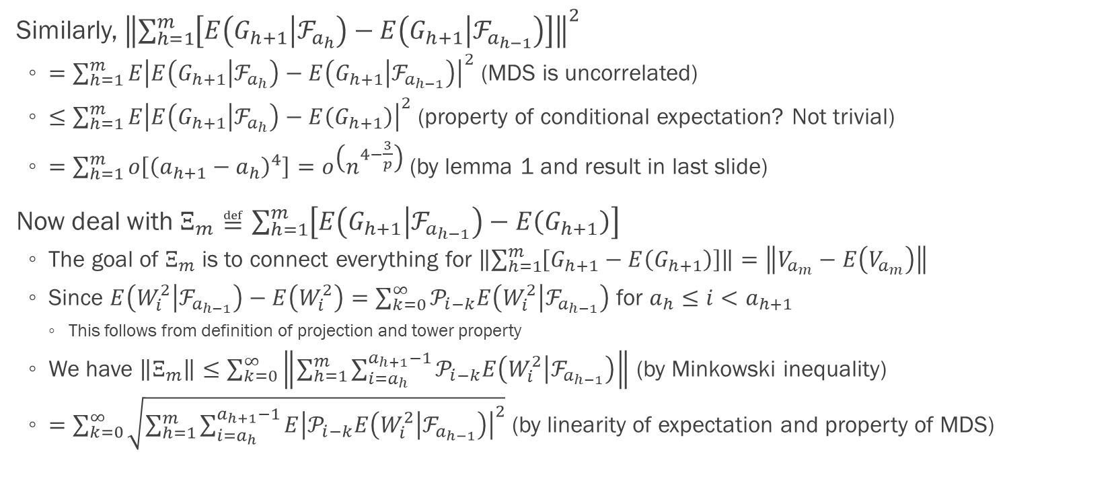
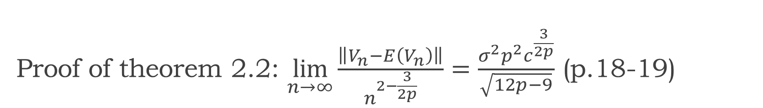
Proof of theorem 2.2: $\lim_{n→∞}{\frac{\left\|V_{n}−E\left(V_{n}\right)\right\|}{n^{2−\frac{3}{2p}}}}=\frac{σ^{2}p^{2}c^{\frac{3}{2p}}}{\sqrt{12p−9}}$ (p.18-19)
Similarly, ${\left\|\sum_{h=1}^{m}{\left[E\left(G_{h+1} | ℱ_{a_{h}}\right)−E\left(G_{h+1} | ℱ_{a_{h−1}}\right)\right]}\right\|}^{2}$
$=\sum_{h=1}^{m}{E{\left|E\left(G_{h+1} | ℱ_{a_{h}}\right)−E\left(G_{h+1} | ℱ_{a_{h−1}}\right)\right|}^{2}}$ (MDS is uncorrelated)
$≤\sum_{h=1}^{m}{E{\left|E\left(G_{h+1} | ℱ_{a_{h}}\right)−E\left(G_{h+1}\right)\right|}^{2}}$ (property of conditional expectation? Not trivial)
$=\sum_{h=1}^{m}{o\left[{\left(a_{h+1}−a_{h}\right)}^{4}\right]}=o\left(n^{4−\frac{3}{p}}\right)$ (by lemma 1 and result in last slide)
Now deal with $Ξ_{m}≝\sum_{h=1}^{m}{\left[E\left(G_{h+1} | ℱ_{a_{h−1}}\right)−E\left(G_{h+1}\right)\right]}$
The goal of $Ξ_{m}$ is to connect everything for $\left\|\sum_{h=1}^{m}{\left[G_{h+1}−E\left(G_{h+1}\right)\right]}\right\|=\left\|V_{a_{m}}−E\left(V_{a_{m}}\right)\right\|$
Since $E\left(W_{i}^{2} | ℱ_{a_{h−1}}\right)−E\left(W_{i}^{2}\right)=\sum_{k=0}^{∞}{𝒫_{i−k}E\left(W_{i}^{2} | ℱ_{a_{h−1}}\right)}$ for $a_{h}≤i<a_{h+1}$
This follows from definition of projection and tower property
We have $\left\|Ξ_{m}\right\|≤\sum_{k=0}^{∞}{\left\|\sum_{h=1}^{m}{\sum_{i=a_{h}}^{a_{h+1}−1}{𝒫_{i−k}E\left(W_{i}^{2} | ℱ_{a_{h−1}}\right)}}\right\|}$ (by Minkowski inequality)
$=\sum_{k=0}^{∞}{\sqrt{\sum_{h=1}^{m}{\sum_{i=a_{h}}^{a_{h+1}−1}{E{\left|𝒫_{i−k}E\left(W_{i}^{2} | ℱ_{a_{h−1}}\right)\right|}^{2}}}}}$ (by linearity of expectation and property of MDS)

Slide 43
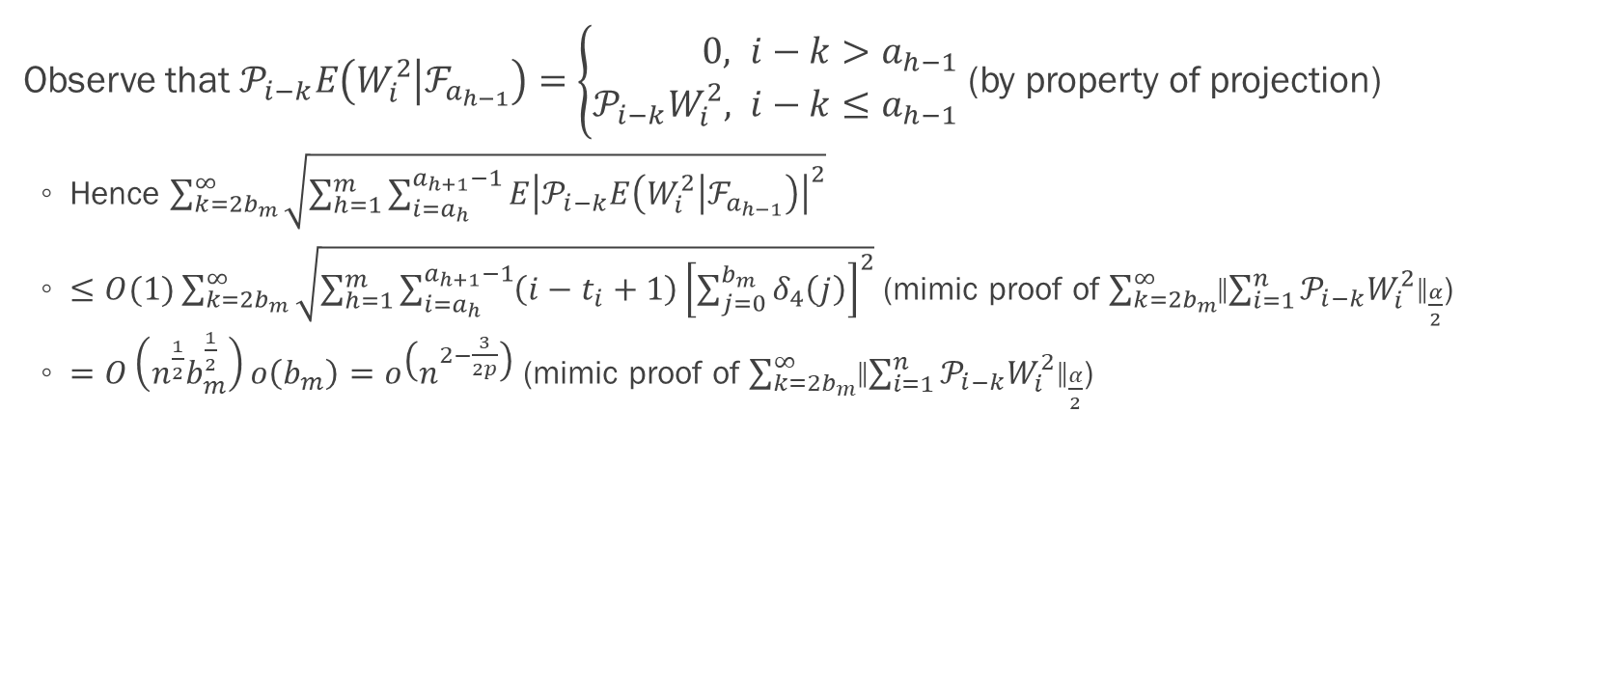

Proof of theorem 2.2: $\lim_{n→∞}{\frac{\left\|V_{n}−E\left(V_{n}\right)\right\|}{n^{2−\frac{3}{2p}}}}=\frac{σ^{2}p^{2}c^{\frac{3}{2p}}}{\sqrt{12p−9}}$ (p.19)
Observe that $𝒫_{i−k}E\left(W_{i}^{2} | ℱ_{a_{h−1}}\right)=\left\{\begin{aligned}0&, i−k>a_{h−1} \\ 𝒫_{i−k}W_{i}^{2}&, i−k≤a_{h−1}\end{aligned}\right.$ (by property of projection)
Hence $\sum_{k=2b_{m}}^{∞}{\sqrt{\sum_{h=1}^{m}{\sum_{i=a_{h}}^{a_{h+1}−1}{E{\left|𝒫_{i−k}E\left(W_{i}^{2} | ℱ_{a_{h−1}}\right)\right|}^{2}}}}}$
$≤O(1)\sum_{k=2b_{m}}^{∞}{\sqrt{\sum_{h=1}^{m}{\sum_{i=a_{h}}^{a_{h+1}−1}{\left(i−t_{i}+1\right){\left[\sum_{j=0}^{b_{m}}{δ_{4}\left(j\right)}\right]}^{2}}}}}$ (mimic proof of $\sum_{k=2b_{m}}^{∞}{{\left\|\sum_{i=1}^{n}{𝒫_{i−k}W_{i}^{2}}\right\|}_{\frac{α}{2}}}$)
$=O\left(n^{\frac{1}{2}}b_{m}^{\frac{1}{2}}\right)o\left(b_{m}\right)=o\left(n^{2−\frac{3}{2p}}\right)$ (mimic proof of $\sum_{k=2b_{m}}^{∞}{{\left\|\sum_{i=1}^{n}{𝒫_{i−k}W_{i}^{2}}\right\|}_{\frac{α}{2}}}$)

Slide 44
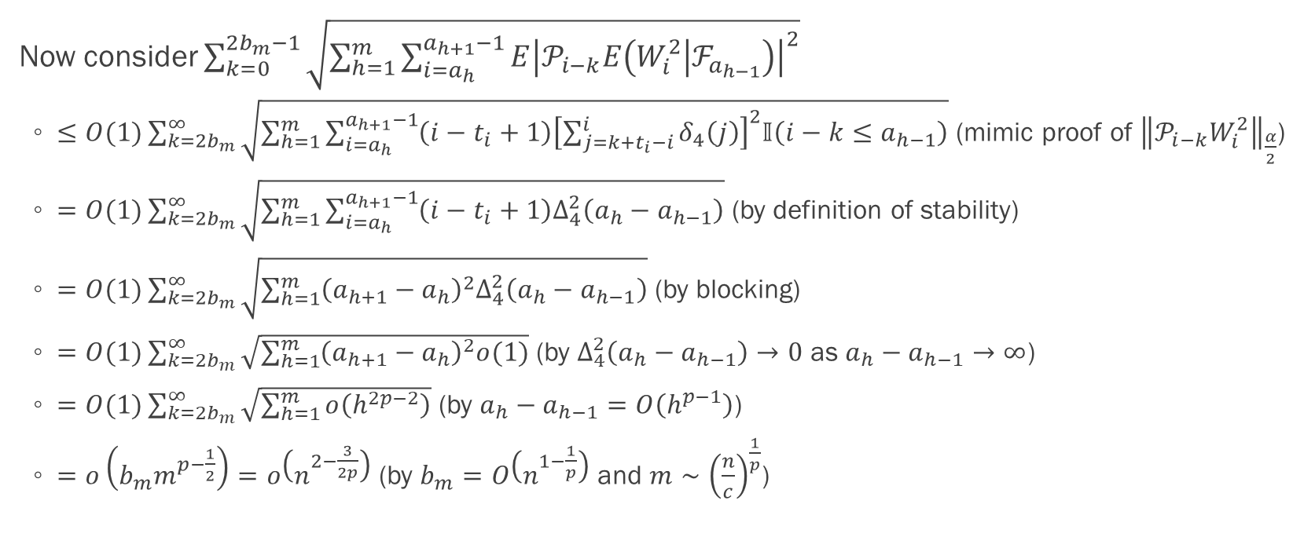
Proof of theorem 2.2: $\lim_{n→∞}{\frac{\left\|V_{n}−E\left(V_{n}\right)\right\|}{n^{2−\frac{3}{2p}}}}=\frac{σ^{2}p^{2}c^{\frac{3}{2p}}}{\sqrt{12p−9}}$ (p.19)
Now consider $\sum_{k=0}^{2b_{m}−1}{\sqrt{\sum_{h=1}^{m}{\sum_{i=a_{h}}^{a_{h+1}−1}{E{\left|𝒫_{i−k}E\left(W_{i}^{2} | ℱ_{a_{h−1}}\right)\right|}^{2}}}}}$
$≤O(1)\sum_{k=2b_{m}}^{∞}{\sqrt{\sum_{h=1}^{m}{\sum_{i=a_{h}}^{a_{h+1}−1}{\left(i−t_{i}+1\right){\left[\sum_{j=k+t_{i}−i}^{i}{δ_{4}\left(j\right)}\right]}^{2}𝕀\left(i−k≤a_{h−1}\right)}}}}$ (mimic proof of ${\left\|𝒫_{i−k}W_{i}^{2}\right\|}_{\frac{α}{2}}$)
$=O(1)\sum_{k=2b_{m}}^{∞}{\sqrt{\sum_{h=1}^{m}{\sum_{i=a_{h}}^{a_{h+1}−1}{\left(i−t_{i}+1\right)Δ_{4}^{2}\left(a_{h}−a_{h−1}\right)}}}}$ (by definition of stability)
$=O(1)\sum_{k=2b_{m}}^{∞}{\sqrt{\sum_{h=1}^{m}{{\left(a_{h+1}−a_{h}\right)}^{2}Δ_{4}^{2}\left(a_{h}−a_{h−1}\right)}}}$ (by blocking)
$=O(1)\sum_{k=2b_{m}}^{∞}{\sqrt{\sum_{h=1}^{m}{{\left(a_{h+1}−a_{h}\right)}^{2}o(1)}}}$ (by $Δ_{4}^{2}\left(a_{h}−a_{h−1}\right)→0$ as $a_{h}−a_{h−1}→∞$)
$=O(1)\sum_{k=2b_{m}}^{∞}{\sqrt{\sum_{h=1}^{m}{o\left(h^{2p−2}\right)}}}$ (by $a_{h}−a_{h−1}=O\left(h^{p−1}\right)$)
$=o\left(b_{m}m^{p−\frac{1}{2}}\right)=o\left(n^{2−\frac{3}{2p}}\right)$ (by $b_{m}=O\left(n^{1−\frac{1}{p}}\right)$ and $m∼{\left(\frac{n}{c}\right)}^{\frac{1}{p}}$)

Slide 45

Proof of theorem 2.2: $\lim_{n→∞}{\frac{\left\|V_{n}−E\left(V_{n}\right)\right\|}{n^{2−\frac{3}{2p}}}}=\frac{σ^{2}p^{2}c^{\frac{3}{2p}}}{\sqrt{12p−9}}$ (p.19)
We have proved $\lim_{n→∞}{\frac{\left\|\sum_{h=1}^{m}{\left[G_{h+1}−E\left(G_{h+1} | ℱ_{a_{h}}\right)\right]}\right\|}{n^{2−\frac{3}{2p}}}}=\frac{σ^{2}p^{2}c^{\frac{3}{2p}}}{\sqrt{12p−9}}$ (four slides ago)
$\left\|\sum_{h=1}^{m}{\left[G_{h+1}−E\left(G_{h+1} | ℱ_{a_{h}}\right)\right]}\right\|≍\left\|\sum_{h=1}^{m}{\left[G_{h+1}−E\left(G_{h+1}\right)\right]}\right\|=\left\|V_{a_{m+1}}−E\left(V_{a_{m+1}}\right)\right\|$ (last three slides)
It remains to show that $\left\|V_{a_{m+1}}−E\left(V_{a_{m+1}}\right)\right\|≍\left\|V_{n}−E\left(V_{n}\right)\right\|$
Now consider the remainder term $\left\|\sum_{i=n}^{a_{m+1}−1}{\left[W_{i}^{2}−E\left(W_{i}^{2}\right)\right]}\right\|$
$≤\sum_{i=n}^{a_{m+1}−1}{\left\|W_{i}^{2}−E\left(W_{i}^{2}\right)\right\|}$ (by Minkowski inequality)
$≤\sum_{i=n}^{a_{m+1}−1}{\left\|W_{i}^{2}\right\|}$ (since $W_{i}^{2}$ is non negative)
$=O(b_{m}^{2})$ (recall the sum is a isosceles triangular shaped)
$=O\left(n^{2−\frac{2}{p}}\right)≪o\left(n^{2−\frac{3}{2p}}\right)$ (by $b_{m}=O\left(n^{1−\frac{1}{p}}\right)$ and $p>1$)

Slide 46


Proof of lemma 1: $\left\|\sum_{i=1}^{l}{\left[E\left(S_{i}^{2} | ℱ_{1}\right)−E\left(S_{i}^{2}\right)\right]}\right\|=o\left(l^{2}\right)$ (p.20)
Recall $S_{i}=\sum_{j=1}^{i}{X_{j}}$. Mimicking proof of ${\left\|𝒫_{i−k}W_{i}^{2}\right\|}_{\frac{α}{2}}$, we have
$\left\|𝒫_{r}S_{i}^{2}\right\|≤C\sqrt{i}\sum_{j=1}^{i}{δ_{2}\left(j−r\right)}$ for $r≤1$ where $C=2c_{2}Θ_{2}$
Since $\sum_{i=1}^{l}{\left[E\left(S_{i}^{2} | ℱ_{1}\right)−E\left(S_{i}^{2}\right)\right]}=\sum_{r=−∞}^{1}{\sum_{i=1}^{l}{𝒫_{r}S_{i}^{2}}}$ (definition of projection), we have
${\left\|\sum_{i=1}^{l}{\left[E\left(S_{i}^{2} | ℱ_{1}\right)−E\left(S_{i}^{2}\right)\right]}\right\|}^{2}=\sum_{r=−∞}^{1}{{\left\|\sum_{i=1}^{l}{𝒫_{r}S_{i}^{2}}\right\|}^{2}}$ (MDS is uncorrelated)
$≤\sum_{r=−∞}^{1}{{\left(\sum_{i=1}^{l}{\left\|𝒫_{r}S_{i}^{2}\right\|}\right)}^{2}}$ (by Minkowski inequality)
$≤\sum_{r=−∞}^{1}{{\left(Cl^{\frac{3}{2}}\sum_{j=1}^{l}{δ_{2}\left(j−r\right)}\right)}^{2}}$ (by inequality above and bounding $\sum_{j=1}^{i}{δ_{2}\left(j−r\right)}$ with $lδ_{2}\left(j−r\right)$)
Is it possible that $\sum_{j=1}^{i}{δ_{2}\left(j−r\right)}>l⇒\sum_{i=1}^{l}{\sum_{j=1}^{i}{δ_{2}\left(j−r\right)}}>l\sum_{j=1}^{l}{δ_{2}\left(j−r\right)}$? Then this step do not hold
However the result is still correct by considering $\sum_{i=1}^{l}{\sum_{j=1}^{i}{δ_{2}\left(j−r\right)}}≤{\left[\sum_{j=1}^{l}{δ_{2}\left(j−r\right)}\right]}^{2}$
$≤C^{2}l^{3}Δ_{2}\sum_{j=1}^{l}{\sum_{r=−∞}^{1}{δ_{2}\left(j−r\right)}}$ (by ${\left[\sum_{j=1}^{l}{δ_{2}\left(j−r\right)}\right]}^{2}≤Δ_{2}\sum_{j=1}^{l}{δ_{2}\left(j−r\right)}$)
$=O\left(l^{3}\right)o\left(l\right)=o(l^{4})$ (by $Δ_{α}<∞$ for $α>4$)

Slide 47


Proof of lemma 1: $\lim_{l→∞}{\frac{1}{l^{4}}{\left\|\sum_{i=1}^{l}{\left[S_{i}^{2}−E\left(S_{i}^{2}\right)\right]}\right\|}^{2}}=\frac{1}{3}σ^{4}$ (p.21)
Let $A_{l}=\frac{1}{l^{2}}\sum_{i=1}^{l}{S_{i}^{2}}$. By invariance principle and continuous mapping theorem,
$A_{l}\underset{→}{d}σ^{2}\int_{0}^{1}{W_{t}^{2}dt}$ (continuous mapping changes sum to integral, probably typo for IB)
By theorem 1 in Wu (2007), ${\left\|S_{i}\right\|}_{α}=O\left(\sqrt{i}\right)$ (moment inequality)
Hence ${\left\|A_{l}\right\|}_{\frac{α}{2}}≤\frac{1}{l^{2}}\sum_{i=1}^{l}{{\left\|S_{i}^{2}\right\|}_{\frac{α}{2}}}$ (by Minkowski inequality)
$≤\frac{1}{l^{2}}\sum_{i=1}^{l}{{\left\|S_{i}\right\|}_{α}^{2}}$ (by definition of norm, should be equal?)
$=\frac{1}{l^{2}}\sum_{i=1}^{l}{O(i)}=O(1)$ (by moment inequality)
Since $\frac{α}{2}>2$, $\left\{{\left[A_{l}−E\left(A_{l}\right)\right]}^{2}, l≥1\right\}$ is uniformly integrable (Chow and Teicher, 1988)
Hence weak convergence of $A_{l}$ implies the $ℒ^{2}$ moment convergence, which is
$E\left\{{\left[A_{l}−E\left(A_{l}\right)\right]}^{2}\right\}→σ^{4}E{\left\{\int_{0}^{1}{\left[W_{t}^{2}−E\left(W_{t}^{2}\right)\right]dt}\right\}}^{2}=\frac{1}{3}σ^{4}$ (by stochastic calculus, not trivial…)

Slide 48


Proof of lemma 1: $E{\left\{\int_{0}^{1}{\left[W_{t}^{2}−E\left(W_{t}^{2}\right)\right]dt}\right\}}^{2}=\frac{1}{3}$
Let $f\left(t,w\right)=\frac{1}{6}w^{4}$. We have $\frac{∂f}{∂t}=0$, $\frac{∂f}{∂w}=\frac{2}{3}w^{3}$ and $\frac{∂^{2}f}{∂w^{2}}=2w^{2}$. Note that $μ=0$ and $σ=1$.
$df\left(t,W_{t}\right)=\left[\frac{∂f}{∂t}+μ\frac{∂f}{∂W_{t}}+\frac{1}{2}σ^{2}\frac{∂^{2}f}{∂W_{t}^{2}}\right]dt+σ\frac{∂f}{∂W_{t}}dW_{t}=W_{t}^{2}dt+\frac{2}{3}W_{t}^{3}{dW}_{t}$ (by Itô’s lemma)
Rearranging the terms, $\int_{0}^{1}{W_{t}^{2}dt}=\frac{1}{6}W_{1}^{4}−\frac{2}{3}\int_{0}^{1}{W_{t}^{3}{dW}_{t}}=\frac{1}{2}+\sqrt{\frac{1}{3}}Z$ where $Z∼N(0,1)$
$E\left(\int_{0}^{1}{W_{t}^{2}dt}\right)=\frac{1}{6}E\left(W_{1}^{4}\right)=\frac{3‼}{6}=\frac{1}{2}$ (by martingale property and $E\left(X^{2n}\right)=σ^{2n}\left(2n−1\right)‼$ if $X∼N(0,σ^{2})$. See this Q&A)
$E\left[{\left(\int_{0}^{1}{W_{t}^{2}dt}\right)}^{2}\right]=E\left(\int_{0}^{1}{\int_{0}^{1}{W_{t}^{2}W_{s}^{2}dtds}}\right)=\int_{0}^{1}{\int_{0}^{1}{E\left(W_{t}^{2}W_{s}^{2}\right)dtds}}$ (by Fubini’s theorem)
$=\int_{0}^{1}{\int_{0}^{s}{E\left[{\left(W_{s}−W_{t}\right)}^{2}W_{t}^{2}+2\left(W_{s}−W_{t}\right)W_{t}^{3}+W_{t}^{4}\right]dtds}}+\int_{0}^{1}{\int_{s}^{1}{E\left[{\left(W_{t}−W_{s}\right)}^{2}W_{s}^{2}+2\left(W_{t}−W_{s}\right)W_{s}^{3}+W_{s}^{4}\right]dtds}}$
$=\int_{0}^{1}{\int_{0}^{s}{\left[\left(s−t\right)t+3t^{2}\right]dtds}}+\int_{0}^{1}{\int_{s}^{1}{\left[\left(t−s\right)s+3s^{2}\right]dtds}}$ (by independent increment and $E\left(X^{2n+1}\right)=0$ if $X∼N(0,σ^{2})$)
$=\frac{7}{24}+\frac{7}{24}=\frac{7}{12}$, so $Var\left(\int_{0}^{1}{W_{t}^{2}dt}\right)=\frac{7}{12}−\frac{1}{4}=\frac{1}{3}$
On the other hand, $\int_{0}^{1}{E\left(W_{t}^{2}\right)dt}=\int_{0}^{1}{tdt}=\frac{1}{2}$ (since $W_{t}∼N(0,t)$)
Hence using representation, $E{\left\{\int_{0}^{1}{\left[W_{t}^{2}−E\left(W_{t}^{2}\right)\right]dt}\right\}}^{2}=E\left(\frac{1}{3}Z^{2}\right)=\frac{1}{3}$

Slide 49

Proof of theorem 2.2 and lemma 1: summary of techniques
Stochastic calculus (my RMSC5102 note has a quick summary)
Useful when we combine invariance principle and continuous mapping theorem
Break down product of wiener process into sum of independent increment (see last slide)
Vitali convergence theorem: a sequence of random variables converging in probability also converge in the mean if and only if they are uniformly integrable
A class of random variables bounded in $L^{p}, p>1$ is uniformly integrable (see two slides ago)

Slide 50

Convergence rate, $α=2$
Section 3.2.3

Slide 51


Proof of theorem 2.3: $E\left(V_{n}−v_{n}σ^{2}\right)=O\left[n^{1+\left(1−q\right)\left(1−\frac{1}{p}\right)}\right]$ (p.20)
We do not have moment inequality when $α=2$ (i.e. in $ℒ^{1}$). Alternative strategy is needed.
Let $j>0$. To bound the autocovariance, we have $\left|γ\left(j\right)\right|=\left|E\left(X_{0}X_{j}\right)\right|$
$=\left|E\left[\sum_{i∈ℤ}{\left(𝒫_{i}X_{0}\right)\left(𝒫_{i}X_{j}\right)}\right]\right|$ (projection decomposition, $X_{j}=\sum_{i∈ℤ}{𝒫_{i}X_{j}}$)
$≤\sum_{i∈ℤ}{E\left|\left(𝒫_{i}X_{0}\right)\left(𝒫_{i}X_{j}\right)\right|}$ (by Minkowski inequality)
$≤\sum_{i∈ℤ}{\left\|\left(𝒫_{i}X_{0}\right)\right\|\left\|\left(𝒫_{i}X_{j}\right)\right\|}$ (by Cauchy–Schwarz inequality)
Orthogonality of projection gives a equal sign here but it does not affect the result
$≤\sum_{i=0}^{∞}{ω\left(i\right)ω\left(i+j\right)}$ (by ${‖𝒫_{0}X_{i}‖}_{p}≤ω_{p}(i)$ and $ω_{p}\left(i\right)=0$ if $i<0$)
For $S_{l}=X_{1}+…+X_{l}$, since $\sum_{j=0}^{∞}{j^{q}ω\left(j\right)}<∞$ for some $q∈(0,1]$ (by assumption)
We have $\left|E\left(S_{l}^{2}\right)−lσ^{2}\right|=\left|lγ\left(0\right)+2\sum_{j=1}^{l}{\left(l−j\right)γ\left(j\right)}−l\sum_{j∈ℤ}{γ(j)}\right|$ (by representation of TAVC)
$≤2\sum_{j=1}^{∞}{\min\left(j,l\right)\left|γ\left(j\right)\right|}$ (by Minkowski inequality)
$≤2\sum_{j=1}^{∞}{{\min\left(j,l\right)}^{1−q}\sum_{i=0}^{∞}{{\min\left(j,l\right)}^{q}ω\left(i\right)ω\left(i+j\right)}}=O\left(l^{1−q}\right)$ (by $\sum_{j=0}^{∞}{j^{q}ω\left(j\right)}<∞$)

Slide 52

Proof of theorem 2.3: $E\left(V_{n}−v_{n}σ^{2}\right)=O\left[n^{1+\left(1−q\right)\left(1−\frac{1}{p}\right)}\right]$ (p.20)
Combining the results, we have $\left|E\left(V_{n}−v_{n}σ^{2}\right)\right|$ ($t_{n}$ should be $v_{n}$, probably typo)
$≤\sum_{i=1}^{n}{\left|E\left(W_{i}\right)−\left(i−t_{i}+1\right)σ^{2}\right|}$ (by Minkowski inequality)
$=\sum_{i=1}^{n}{O\left[{\left(i−t_{i}+1\right)}^{1−q}\right]}$ (by $\left|E\left(S_{l}^{2}\right)−lσ^{2}\right|=O\left(l^{1−q}\right)$)
$=O\left(nb_{m}^{1−q}\right)$ (since $b_{m}$ is the bound of batch size)
$=O\left[n^{1+\left(1−q\right)\left(1−\frac{1}{p}\right)}\right]$ (by $b_{m}=O\left(n^{1−\frac{1}{p}}\right)$)

Slide 53

Proof of theorem 2.3: summary of techniques
Moment inequality is not available in $ℒ^{1}$
Bound the target using projection decomposition and Wu’s dependence measures
The polynomial decay rate of stability determines convergence rate

Slide 54
Almost sure convergence
Section 3.3

Slide 55

Almost sure convergence (p.9)
Glynn and Whitt (1992) argued that strongly consistent estimate of $σ$ is needed
For asymptotic validity of sequential confidence intervals
Hence we need to consider the almost sure convergence behaviour for MCMC application
Corollary 3: Under the conditions in corollary 2,
i.e. choose $a_{k}=\left\lfloor ck^{p}\right\rfloor$, $p=\frac{\frac{1}{2}+q}{q−\frac{1}{2}+\frac{2}{α}}$ and assume $X_{i}∈ℒ^{α}$, $E\left(X_{i}\right)=0$ and $Δ_{α}<∞$ for some $α>2$
Or $X_{i}∈ℒ^{2}$, $E\left(X_{i}\right)=0$ and $\sum_{j=0}^{∞}{j^{q}ω\left(j\right)}<∞$ for some $q∈(0,1]$
We have ${\left\|\max_{n≤N}\left|V_{n}−E\left(V_{n}\right)\right|\right\|}_{\frac{α}{2}}=O\left(N^{τ}\log{N}\right)$ where $τ=\frac{3}{2}−\frac{3}{2p}+\frac{2}{α}$
Note that $τ$ is the convergence rate from theorem 2
Also $V_{N}−E\left(V_{N}\right)=o_{a.s.}\left[N^{τ}{\left(\log{N}\right)}^{2}\right]$ and $\frac{V_{N}}{v_{N}}−σ^{2}=o_{a.s.}\left[N^{\frac{2}{α}−\frac{1}{2}−\frac{1}{2p}}{\left(\log{N}\right)}^{2}\right]$
Possible to improve using strong invariance principle in Berkes, Liu and Wu (2014)?

Slide 56


Proof of corollary 3: ${\left\|\max_{n≤N}\left|V_{n}−E\left(V_{n}\right)\right|\right\|}_{\frac{α}{2}}=O\left(N^{τ}\log{N}\right)$ (p.21)
Choose $d∈ℕ$ such that $2^{d−1}<N≤2^{d}$ (for the use of Borel-Cantelli lemma later?)
For $1≤a<b$, ${\left\|V_{a}−V_{b}−E\left(V_{b}−V_{a}\right)\right\|}_{\frac{α}{2}}={\left\|\sum_{i=a+1}^{b}{\left[W_{i}^{2}−E\left(W_{i}^{2}\right)\right]}\right\|}_{\frac{α}{2}}$
$≤\sum_{k=0}^{∞}{{\left\|\sum_{i=a+1}^{b}{𝒫_{i−k}W_{i}^{2}}\right\|}_{\frac{α}{2}}}$ (by projection decomposition and Minkowski inequality)
$=\sum_{k=0}^{∞}{{\left[\sum_{i=a}^{b}{{\left(i−t_{i}+1\right)}^{\frac{α}{4}}}\right]}^{\frac{2}{α}}O\left(b^{1−\frac{1}{p}}\right)}$ (mimic proof of $\sum_{k=0}^{2b_{m}−1}{{\left\|\sum_{i=1}^{n}{𝒫_{i−k}W_{i}^{2}}\right\|}_{\frac{α}{2}}}$)
$=O\left[{\left(b−a\right)}^{\frac{2}{α}}b^{\frac{1}{2}\left(1−\frac{1}{p}\right)}\right]O\left(b^{1−\frac{1}{p}}\right)=O\left[{\left(b−a\right)}^{\frac{2}{α}}b^{\frac{3}{2}\left(1−\frac{1}{p}\right)}\right]$
Note that the bound of batch/block size is $b_{m}=O\left(n^{1−\frac{1}{p}}\right)$ and bound of sample size is $b$ here

Slide 57


Proof of corollary 3: ${\left\|\max_{n≤N}\left|V_{n}−E\left(V_{n}\right)\right|\right\|}_{\frac{α}{2}}=O\left(N^{τ}\log{N}\right)$ (p.21-22)
By proposition 1 in Wu (2007), ${\left\|\max_{n≤2^{d}}\left|V_{n}−E\left(V_{n}\right)\right|\right\|}_{\frac{α}{2}}$ (maximal inequality)
$≤\sum_{r=0}^{d}{{\left[\sum_{l=1}^{2^{d−r}}{{\left\|V_{2^{r}l}−V_{2^{r}\left(l−1\right)}−E\left[V_{2^{r}l}−V_{2^{r}\left(l−1\right)}\right]\right\|}_{\frac{α}{2}}^{\frac{α}{2}}}\right]}^{\frac{2}{α}}}$
$=\sum_{r=0}^{d}{{\left\{\sum_{l=1}^{2^{d−r}}{O{\left[{\left(2^{r}\right)}^{\frac{2}{α}}{\left(2^{r}l\right)}^{\frac{3}{2}\left(1−\frac{1}{p}\right)}\right]}^{\frac{α}{2}}}\right\}}^{\frac{2}{α}}}$ (by moment inequality proved in last slide)
$=\sum_{r=0}^{d}{{\left\{O\left[{(2^{r})}^{1+\frac{3α}{4}\left(1−\frac{1}{p}\right)}\right]\sum_{l=1}^{2^{d−r}}{O\left[l^{\frac{3α}{4}\left(1−\frac{1}{p}\right)}\right]}\right\}}^{\frac{2}{α}}}$ (by independence of summation index)
$≤\sum_{r=0}^{d}{{\left\{O\left[{(2^{d})}^{1+\frac{3α}{4}\left(1−\frac{1}{p}\right)}\right]\right\}}^{\frac{2}{α}}}$ (since $l≤2^{d−r}$)
$=O\left(d+1\right)O\left[{\left(2^{d}\right)}^{\frac{2}{α}+\frac{3}{2}−\frac{3}{2p}}\right]$
$=O\left(N^{τ}\log{N}\right)$ (since $τ=\frac{3}{2}−\frac{3}{2p}+\frac{2}{α}$ and $N≤2^{d}⇒\log{N}≤d$)

Slide 58


Proof of corollary 3: $V_{N}−E\left(V_{N}\right)=o_{a.s.}\left[N^{τ}{\left(\log{N}\right)}^{2}\right]$ (p.22)
Note that $\frac{α}{2}>1$. From ${\left\|\max_{n≤N}\left|V_{n}−E\left(V_{n}\right)\right|\right\|}_{\frac{α}{2}}=O\left(N^{τ}\log{N}\right)$ (proved in last two slides),
We have $\frac{1}{{\left(2^{dτ}d^{2}\right)}^{\frac{α}{2}}}\sum_{d=1}^{∞}{{\left\|\max_{n≤2^{d}}\left|V_{n}−E\left(V_{n}\right)\right|\right\|}_{\frac{α}{2}}^{\frac{α}{2}}}=\sum_{d=1}^{∞}{\frac{O{\left[\left(d+1\right)2^{dτ}\right]}^{\frac{α}{2}}}{{\left(2^{dτ}d^{2}\right)}^{\frac{α}{2}}}}=\sum_{d=1}^{∞}{O\left(d^{−\frac{α}{2}}\right)}<∞$
Hence $V_{N}−E\left(V_{N}\right)=o_{a.s.}\left[N^{τ}{\left(\log{N}\right)}^{2}\right]$ (by Borel-Cantelli lemma)
Borel-Cantelli lemma: for a sequence of events $E_{1},…$, if $\sum_{n=1}^{∞}{P\left(E_{n}\right)}<∞$, then $P\left(\underset{n→∞}{limsup}{E_{n}}\right)=0$
$P\left[\frac{\max_{n≤N}\left|V_{n}−E\left(V_{n}\right)\right|}{N^{τ}{\left(\log{N}\right)}^{2}}>ε\right]=E\left[𝕀\left(\frac{\max_{n≤N}\left|V_{n}−E\left(V_{n}\right)\right|}{N^{τ}{\left(\log{N}\right)}^{2}}>ε\right)\right]$ for all $ε>0$ (write probability as expectation of indicator)
$≤E\left|\frac{\max_{n≤N}\left|V_{n}−E\left(V_{n}\right)\right|}{N^{τ}{\left(\log{N}\right)}^{2}}\right|$ (not sure if this is true)
$≤\frac{1}{N^{\frac{τα}{2}}{\left(\log{N}\right)}^{α}}{\left\|\max_{n≤2^{d}}\left|V_{n}−E\left(V_{n}\right)\right|\right\|}_{\frac{α}{2}}^{\frac{α}{2}}$ (by property of norm and $\frac{α}{2}>1$)

Slide 59


Proof of corollary 3: $\frac{V_{N}}{v_{N}}−σ^{2}=o_{a.s.}\left[N^{\frac{2}{α}−\frac{1}{2}−\frac{1}{2p}}{\left(\log{N}\right)}^{2}\right]$(p.22)
Note that $V_{N}−E\left(V_{N}\right)=o_{a.s.}\left[N^{τ}{\left(\log{N}\right)}^{2}\right]$ (proved in last slide)
And $E\left(V_{n}−v_{n}σ^{2}\right)=O\left[n^{1+\left(1−q\right)\left(1−\frac{1}{p}\right)}\right]$ (theorem 2.3, probably typo in $t_{n}$)
By choosing optimal rate $p=\frac{\frac{1}{2}+q}{q−\frac{1}{2}+\frac{2}{α}}$, $E\left(V_{N}−v_{N}σ^{2}\right)=O\left(N^{τ}\right)≪o\left[N^{τ}{\left(\log{N}\right)}^{2}\right]$
We have $V_{N}−v_{N}σ^{2}=o_{a.s.}\left[N^{\frac{3}{2}−\frac{3}{2p}+\frac{2}{α}}{\left(\log{N}\right)}^{2}\right]$
Finally recall $v_{N}=O\left(N^{2−\frac{1}{p}}\right)$ (proved in discussion of convergence rate when $μ≠0$)
Hence $\frac{V_{N}}{v_{N}}−σ^{2}=o_{a.s.}\left[N^{\frac{2}{α}−\frac{1}{2}−\frac{1}{2p}}{\left(\log{N}\right)}^{2}\right]$ (little o times big O is little o)

Slide 60
Proof of corollary 3: summary of techniques
Establish almost sure convergence
Use maximal inequality
Apply Borel-Cantelli lemma on maximal with expanding samples
Cantor’s diagonal argument?

Slide 61
Implementation issues
Section 4

Slide 62

Remaining question (p.9)
We can see that choice of block start $a_{k}$ uniquely determines property of recursive TAVC
The batch size $l_{i}$ is determined by the selection rule (e.g. $Δ$SR, TSR, PSR)
Under the simple choice $a_{k}=\left\lfloor ck^{p}\right\rfloor$, we have established the optimal choice of p
It suffices to find the optimal choice of $c$ in order to minimize AMSE
Assume $Δ_{α}<∞$ for some $α>4$ and $\sum_{j=0}^{∞}{j^{q}ω\left(j\right)}<∞$ for $q=1$
Need $α>4$ for close form of AMSE (T2.2) and $q=1$ for finite bias
By corollary 2, optimal choice of $p=\frac{3}{2}$
Choose data driven estimate of $c$ by procedure in Bühlmann and Künsch (1999)

Slide 63

Close form of AMSE (p.10)
Since $\sum_{j=0}^{∞}{jω\left(j\right)}<∞$, $\sum_{i=1}^{∞}{i\left|γ\left(i\right)\right|}<∞$ (by bound of autocovariance in proof of T2.3)
As $l→∞$, $E\left(S_{l}^{2}\right)−lσ^{2}=−2\sum_{k=1}^{∞}{\min\left(k,l\right)γ\left(k\right)}=−2\sum_{k=1}^{∞}{kγ\left(k\right)}+o\left(1\right)=θ+o(1)$
Keith (and I) usually denote $v_{p}≝\sum_{k=−∞}^{∞}{k^{p}γ\left(k\right)}$ and $u_{p}≝\sum_{k=−∞}^{∞}{k^{p}\left|γ\left(k\right)\right|}$
Thus we have $E\left(V_{n}−v_{n}σ^{2}\right)=nθ+o(n)$
Now we decompose the AMSE in T2.2 into variance and bias^2,
${\left\|\frac{V_{n}}{v_{n}}−σ^{2}\right\|}_{2}^{2}=\frac{1}{v_{n}^{2}}\left[{\left\|V_{n}−E\left(V_{n}\right)\right\|}_{2}^{2}+{\left|E\left(V_{n}\right)−v_{n}σ^{2}\right|}^{2}\right]$
$=\frac{{\left(4p−2\right)}^{2}}{c^{\frac{2}{p}}p^{4}}n^{\frac{2}{p}−4}\left[\frac{p^{4}c^{\frac{3}{p}}}{12p−9}n^{4−\frac{3}{p}}σ^{4}+n^{2}θ^{2}+o\left(n^{2}\right)\right]$ (by $v_{n}∼\frac{c^{\frac{1}{p}}p^{2}}{4p−2}n^{2−\frac{1}{p}}$, T2.2 and the result above)
$=\frac{256}{81c^{\frac{4}{3}}}n^{−\frac{8}{3}}\left[\frac{9c^{2}}{16}σ^{4}n^{2}+θ^{2}n^{2}+o\left(n^{2}\right)\right]$
$=\left(\frac{16}{9}c^{\frac{2}{3}}+\frac{256}{81}c^{−\frac{4}{3}}κ^{2}\right)σ^{4}n^{−\frac{2}{3}}$ where $κ=\frac{\left|θ\right|}{σ^{2}}$

Slide 64



Optimal choice of $c$ (p.10)
The optimal choice of $c$ should minimize $\frac{16}{9}c^{\frac{2}{3}}+\frac{256}{81}c^{−\frac{4}{3}}κ^{2}$
Illustration with SymPy
from sympy import symbols, diff, solve, simplify, Rational, init_printing
init_printing() # for printing Latex in console
c, kappa = symbols("c, kappa", real=True, positive=True) # kappa = v1/sigma^2
# Coefficent of Bias^2 and variance
b2 = Rational(256,81) *c**(-Rational(4,3)) *kappa**2
v = Rational(16,9) *c**(Rational(2,3)) # use Rational(p, q) if you want solution in fraction
mse = b2 +v
dMse = diff(mse,c)
minC = solve(dMse, c) # optimal c
# first root minimize after inspection
simplify(minC[0])
simplify(mse.subs(c, minC[0]))

Slide 65


Estimate optimal $c$ (p.10-11)
By prime factorization, we can see that output of SymPy matches with
Optimal AMSE of ${\hat{σ}}_{ΔSR}^{2}\left(n\right)=\frac{2^{\frac{14}{3}}}{3^{\frac{5}{3}}}θ^{\frac{2}{3}}σ^{\frac{8}{3}}n^{−\frac{2}{3}}$ with optimal $c=\frac{4\sqrt{2}\left|θ\right|}{3σ^{2}}=\frac{4\sqrt{2}}{3}κ$
Literature shows that optimal AMSE of ${\hat{σ}}_{obm}^{2}\left(n\right)=2^{\frac{2}{3}}3^{\frac{1}{3}}θ^{\frac{2}{3}}σ^{\frac{8}{3}}n^{−\frac{2}{3}}$
With batch size $l_{n}=\left\lfloor λ_{∗}n^{\frac{1}{3}}\right\rfloor$ and optimal $λ_{∗}^{3}=\frac{3θ^{2}}{2σ^{4}}⇒κ=\sqrt{\frac{2}{3}λ_{∗}^{3}}$
Recall that we do not know the optimal functional of block start (same for batch size here)
This shows $AMSE\left[{\hat{σ}}_{ΔSR}^{2}\left(n\right)\right]=1.778AMSE[{\hat{σ}}_{obm}^{2}\left(n\right)]$. Chan and Yau’s (2017) TSR and PSR dominate it in MSE sense
Theorem 4.1 in Bühlmann and Künsch (1999) gives $\frac{{\hat{l}}_{n}^{3}}{n}∼\frac{1}{n{\hat{b}}^{3}}∼\frac{3θ^{2}}{2σ^{4}}=λ_{∗}^{3}⇒λ_{∗}={\hat{l}}_{n}n^{−\frac{1}{3}}$
They gives a procedure to estimate ${\hat{l}}_{n}$ via pilot simulation. Hence $n$ is the sample size in pilot simulation here
Note that this is asymptotic. Can we have better pilot procedure for small sample?
Using these relationship, we have $\hat{c}=\frac{8}{3\sqrt{3}}λ_{∗}^{\frac{3}{2}}=\frac{8}{3\sqrt{3}}{\hat{l}}_{n}n^{−\frac{1}{3}}$

Slide 66

Bühlmann and Künsch’s (1999) algorithm (p.10-11)
Let the Tukey-Hanning window $w_{TH}\left(x\right)=\frac{1}{2}\left[1+\cos\left(πx\right)\right]𝕀\left(\left|x\right|≤1\right)$
Let the splt-cosine window $w_{SC}\left(x\right)=\left\{\begin{aligned}\frac{1}{2}\left\{1+\cos\left[5\left(x−0.8\right)π\right]\right\}&, 0.8≤\left|x\right|≤1 \\ 1&, \left|x\right|<0.8 \\ 0&, \left|x\right|>1\end{aligned}\right.$
1) Compute $\hat{γ}\left(k\right)=\frac{1}{n}\sum_{i=1}^{n−\left|k\right|}{\left(X_{i}−{\overline{X}}_{n}\right)\left(X_{i+\left|k\right|}−{\overline{X}}_{n}\right)}$ for $k=1−n,…,n−1$
2) Let $b_{0}=\frac{1}{n}$. For $m=1,2,3,4$, compute $b_{m}=n^{−\frac{1}{3}}{\left[\frac{\sum_{k=1−n}^{n−1}{\hat{γ}{\left(k\right)}^{2}}}{6\sum_{k=1−n}^{n−1}{w_{SC}\left(kb_{m−1}n^{\frac{4}{21}}\right)k^{2}\hat{γ}{\left(k\right)}^{2}}}\right]}^{\frac{1}{3}}$
3) Let ${\hat{l}}_{n}$ be the closest integer of ${\hat{b}}^{−1}$, where $\hat{b}=n^{−\frac{1}{3}}{\left[\frac{2{\left(\sum_{k=1−n}^{n−1}{w_{TH}\left(kb_{4}n^{\frac{4}{21}}\right)\hat{γ}\left(k\right)}\right)}^{2}}{3{\left(\sum_{k=1−n}^{n−1}{w_{SC}\left(kb_{4}n^{\frac{4}{21}}\right)\left|k\right|\hat{γ}\left(k\right)}\right)}^{2}}\right]}^{\frac{1}{3}}$

